Slide 1
2025 NFHS Softball rules powerpoint
Rule Changes
Major Editorial Changes
Points of Emphasis

Slide 2
2025 nfhs softball RULES CHANGES

Slide 3
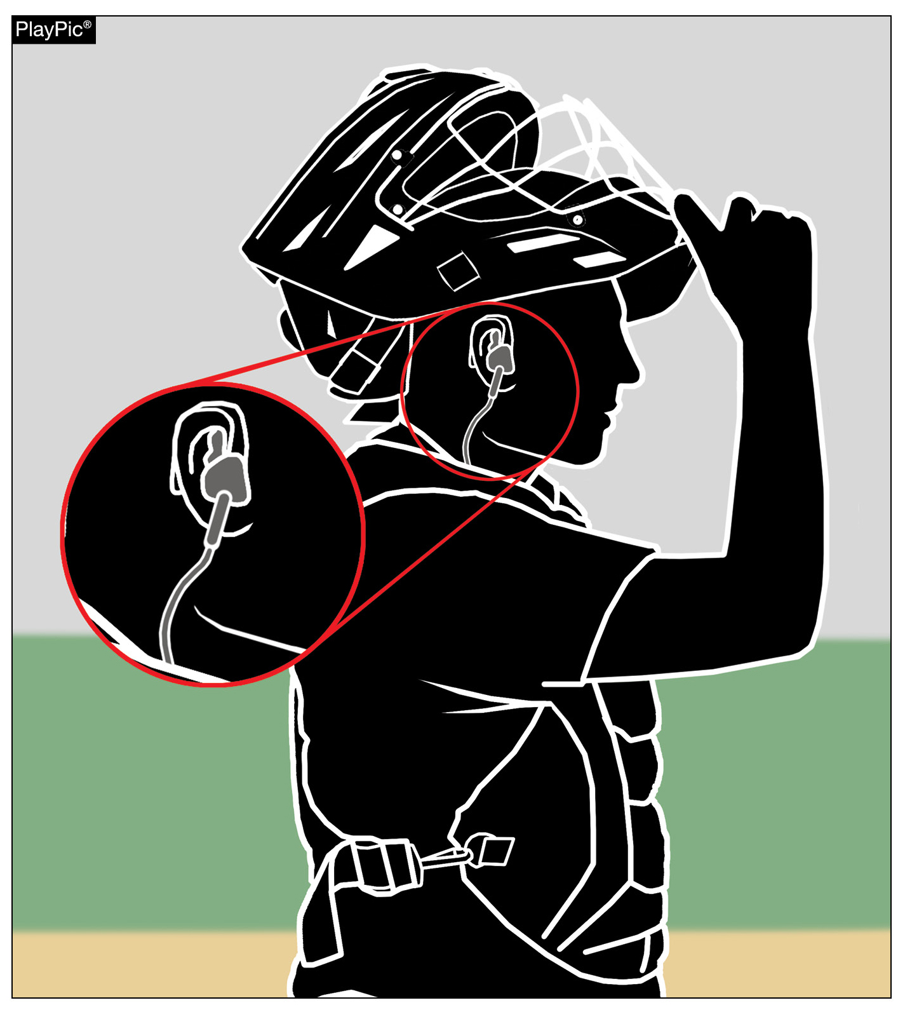
Other equipment
1-8-6 Exception & Penalty
A coach is permitted to use electronic devices in the dugout for one-way communication to the catcher while the team is on defense.
The penalty from Rule 3-6-11 was added to Rule 1-8-6 as well, with violators subject to ejection unless the offense is ruled to be of a minor nature.
Notes:
Rule 1-8-6: A coach is permitted to use electronic devices in the dugout for one-way communication to the catcher while the team is on defense. The penalty from Rule 3-6-11 was added to Rule 1-8-6 as well, with violators subject to ejection unless the offense is ruled to be of a minor nature.
Rationale: The committee has made these changes to support the use of emerging technology within the sport of softball. Being a permissive rule, the use of this one-way electronic communication will allow those who choose to embrace the technology an additional option to communicate with the catcher while on defense.
Comments: A high school softball coach will be able to use electronic devices in the dugout for one-way communication to the catcher while the team is on defense beginning in 2025. This change is the result of analysis of current data, state association experimentation and a positive response from the membership. The committee has made these changes to support the use of emerging technology within the sport of softball. Being a permissive rule, the use of this one-way electronic communication will allow those who choose to embrace the technology an additional option to communicate with the catcher while on defense. It will also maintain the ability for those who prefer a more traditional approach to communicate using signals or a playbook/playcard to continue that approach. Accommodating one-way communication to the catcher brought new language to two different sections of the NFHS Softball Rules Book, starting with Rule 1-8-6. Devices such as earpieces, electronic bands and smartwatches are now permitted as an EXCEPTION within the rule provided the player does not utilize said device to return correspondence to the coaching staff. Since both rules were updated for this change, the penalty from Rule 3-6-11 was added to Rule 1-8-6 as well, with violators subject to ejection unless the offense is ruled to be of a minor nature. This penalty has been in place for Rule 3-6-11 allowing the umpire to issue a warning if the offense is minor and then eject if the offense is repeated.

Slide 4

Bench and field conduct
3-6-11
Communication may only be to the catcher and may not be to any other player on defense or to any offensive player.
While players other than the catcher are permitted to use jewelry, such as watches, they may not use them for the purpose of receiving communication from the dugout. Violators are subject to ejection unless the offense is ruled to be minor in nature.
Notes:
Rule 3-6-11: Communication may only be to the catcher and may not be to any other player on defense or to any offensive player. While players other than the catcher are permitted to use jewelry, such as watches, they may not use them for the purpose of receiving communication from the dugout. Violators are subject to ejection unless the offense is ruled to be minor in nature.
Rationale: Clarifies that a coach may us an electronic device for one-way communication to the catcher while the team is on defense.
Comments: This penalty has been in place for Rule 3-6-11 allowing the umpire to issue a warning if the offense is minor and then eject if the offense is repeated. In addition to permitting the one-way communication devices, the updated version of Rule 3-6-11 regarding Bench and Field Conduct specifies that coaches are prohibited from using the device to communicate with any other team member while on defense or any team member while on offense and the coach cannot use the device outside the dugout/bench area.

Slide 5
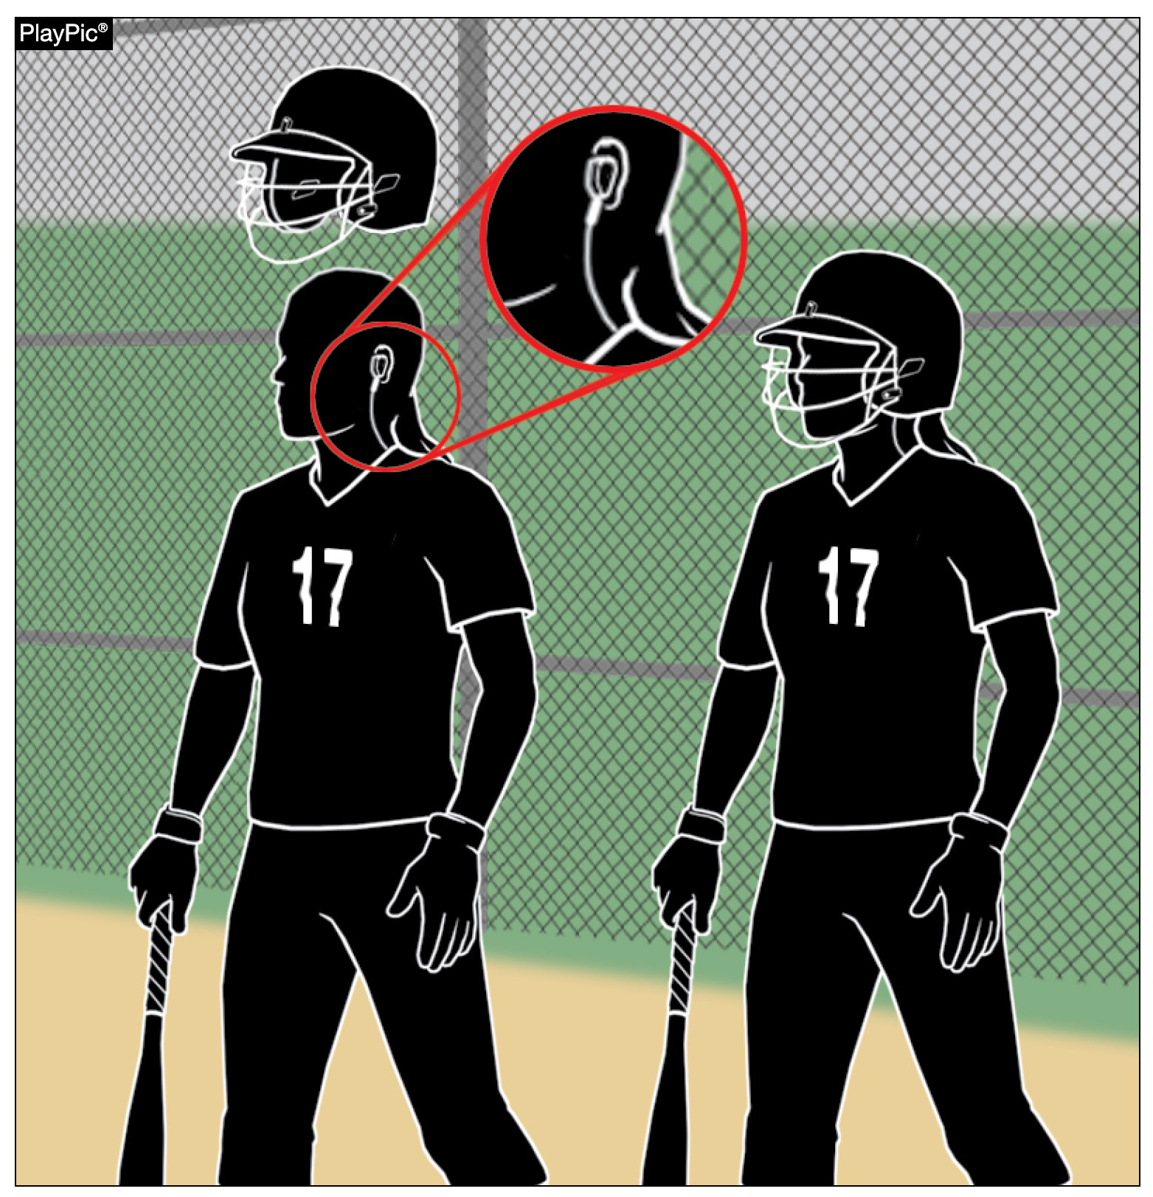
Bench and field conduct
3-6-11
The catcher is not required to remove the one-way communication device while on offense but may not use the device to receive communication.
Notes:
Rule 3-6-11: The catcher is not required to remove the one-way communication device while on offense but may not use the device to receive communication.
Rationale: This rule change specifies that coaches are prohibited from using the device to communicate with any other team member while on defense or any team member while on offense and the coach cannot use the device outside the dugout/bench area.
Comments: Although this rule change only allows communication to the catcher while on defense, earpieces and devices are often difficult to remove. With this in mind, the catcher is not required to remove the one-way communication device when on offense but the device may not be used for communication purposes.

Slide 6
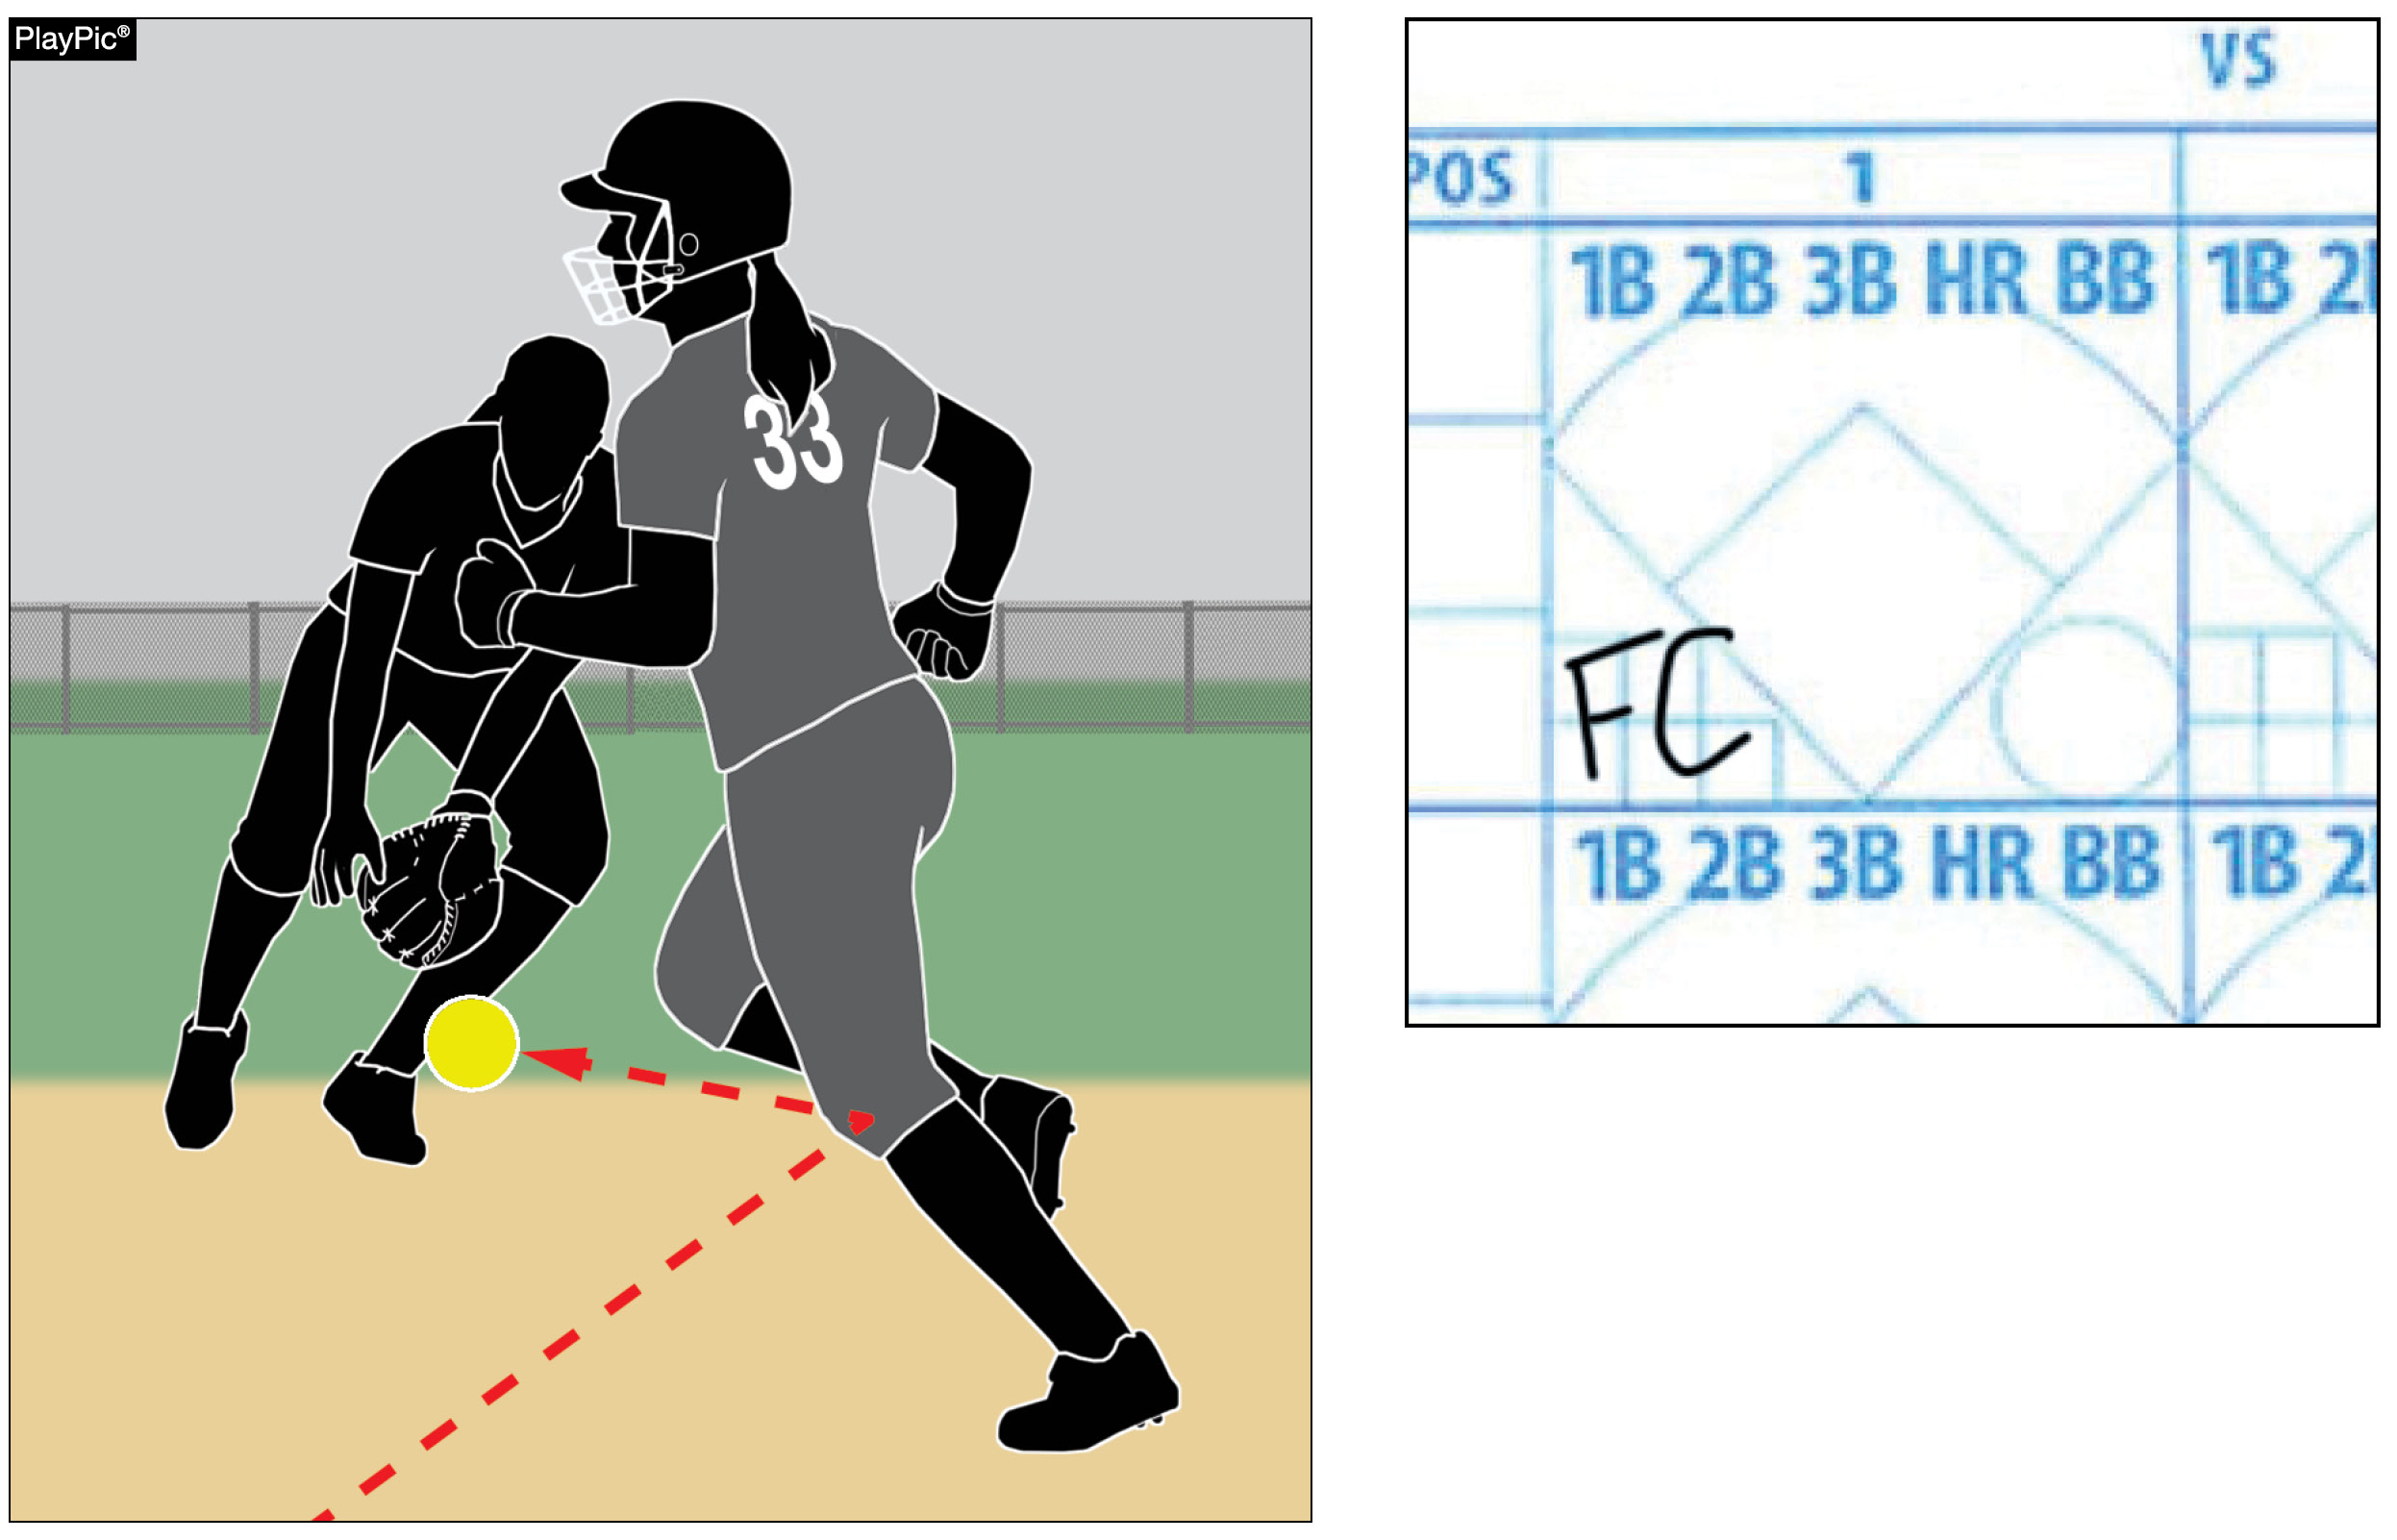
Player’s batting record
9-3-2b
If a batter-runner is awarded first base due to a baserunner’s interference, the batter-runner is credited with a fielder’s choice, not a base hit.
Notes:
Rule 9-3-2b: If a batter-runner is awarded first base due to a baserunner’s interference, the batter-runner is credited with a fielder’s choice, not a base hit.
Rationale: This change corrects an error in the rules book that awarded a base hit in this instance.
Comments: For the purpose of official scorekeeping, if a baserunner is declared out for being hit by a fair batted ball the batter-runner is credited with a fielder’s choice in the scorebook. A runner being hit with a batted ball is a form of interference and is covered in Rule 8-6-11 which specifies that the runner is out and it also lists that the batter-runner is credited with a fielder's choice. Previously, this play was scored as a base hit for the batter.

Slide 7
2025 nfhs softball editorial CHANGES

Slide 8
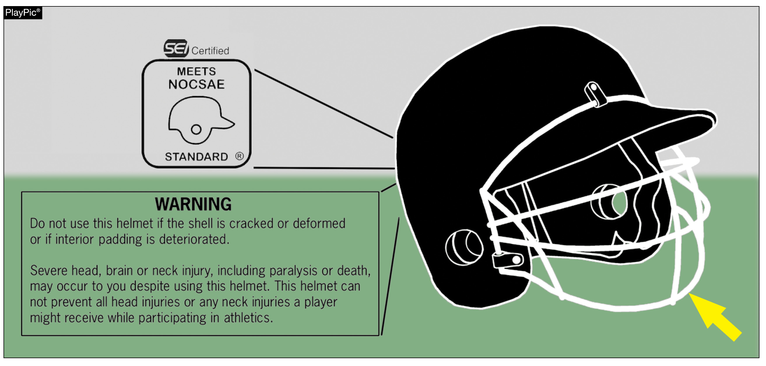
Batting helmets
1-6-6
Batting helmets shall be equipped with a face protector that is certified by SEI to meet the NOCSAE standard.
Notes:
Rule 1-6-6: Batting helmets shall be equipped with a face protector that is certified by SEI to meet the NOCSAE standard.
Rationale: NOCSAE has requested that the language be modified to more clearly represent the certification process.

Slide 9
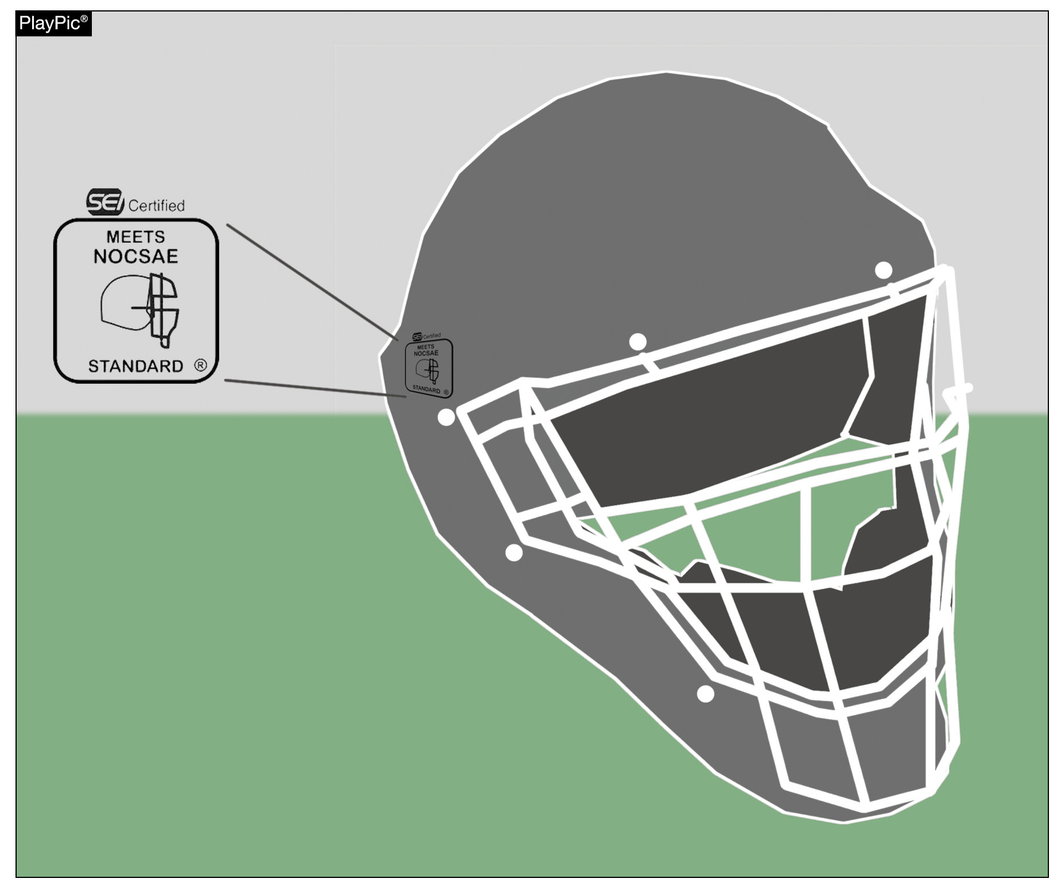
Catcher’s equipment
1-7-1
The catcher shall wear a catcher’s helmet and mask combination that has been certified by SEI to meet the NOCSAE standard at the time of manufacture.
Notes:
Rule 1-7-1: The catcher shall wear a catcher’s helmet and mask combination that has been certified by SEI to meet the NOCSAE standard at the time of manufacture.
Rationale: NOCSAE has requested that the language be modified to more clearly represent the certification process.

Slide 10
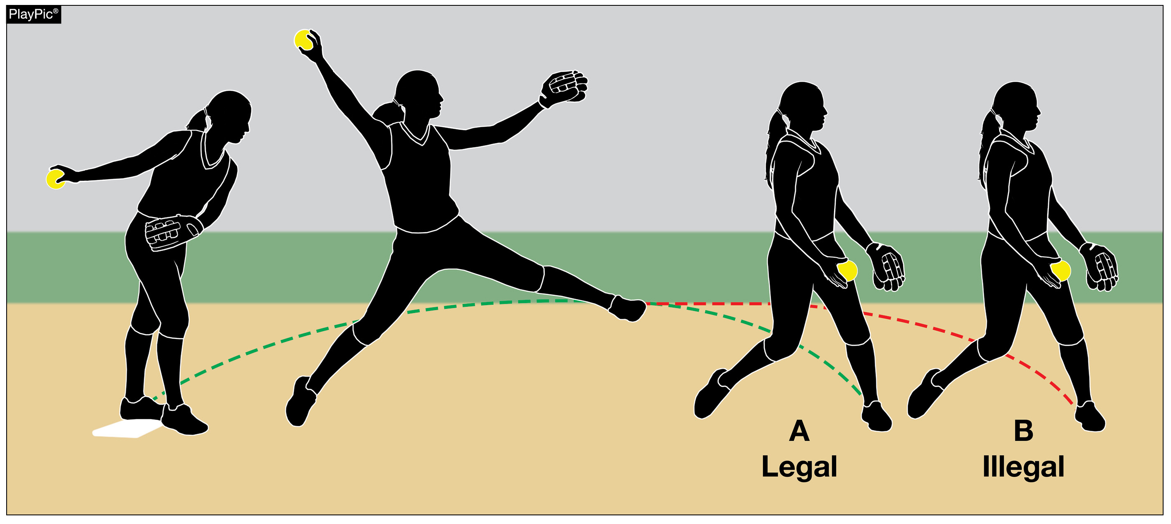
Replant
2-47
A replant of the pivot foot occurs when the pitcher pushes off the playing surface from anywhere other than the pitcher’s plate resulting in the non-pivot foot becoming closer to home plate prior to the act of delivering the pitch.
Notes:
Rule 2-47: A replant of the pivot foot occurs when the pitcher pushes off the playing surface from anywhere other than the pitcher’s plate resulting in the non-pivot foot becoming closer to home plate prior to the act of delivering the pitch.
Rationale: Additional language has been added to align this rule with the pitching motion.

Slide 11
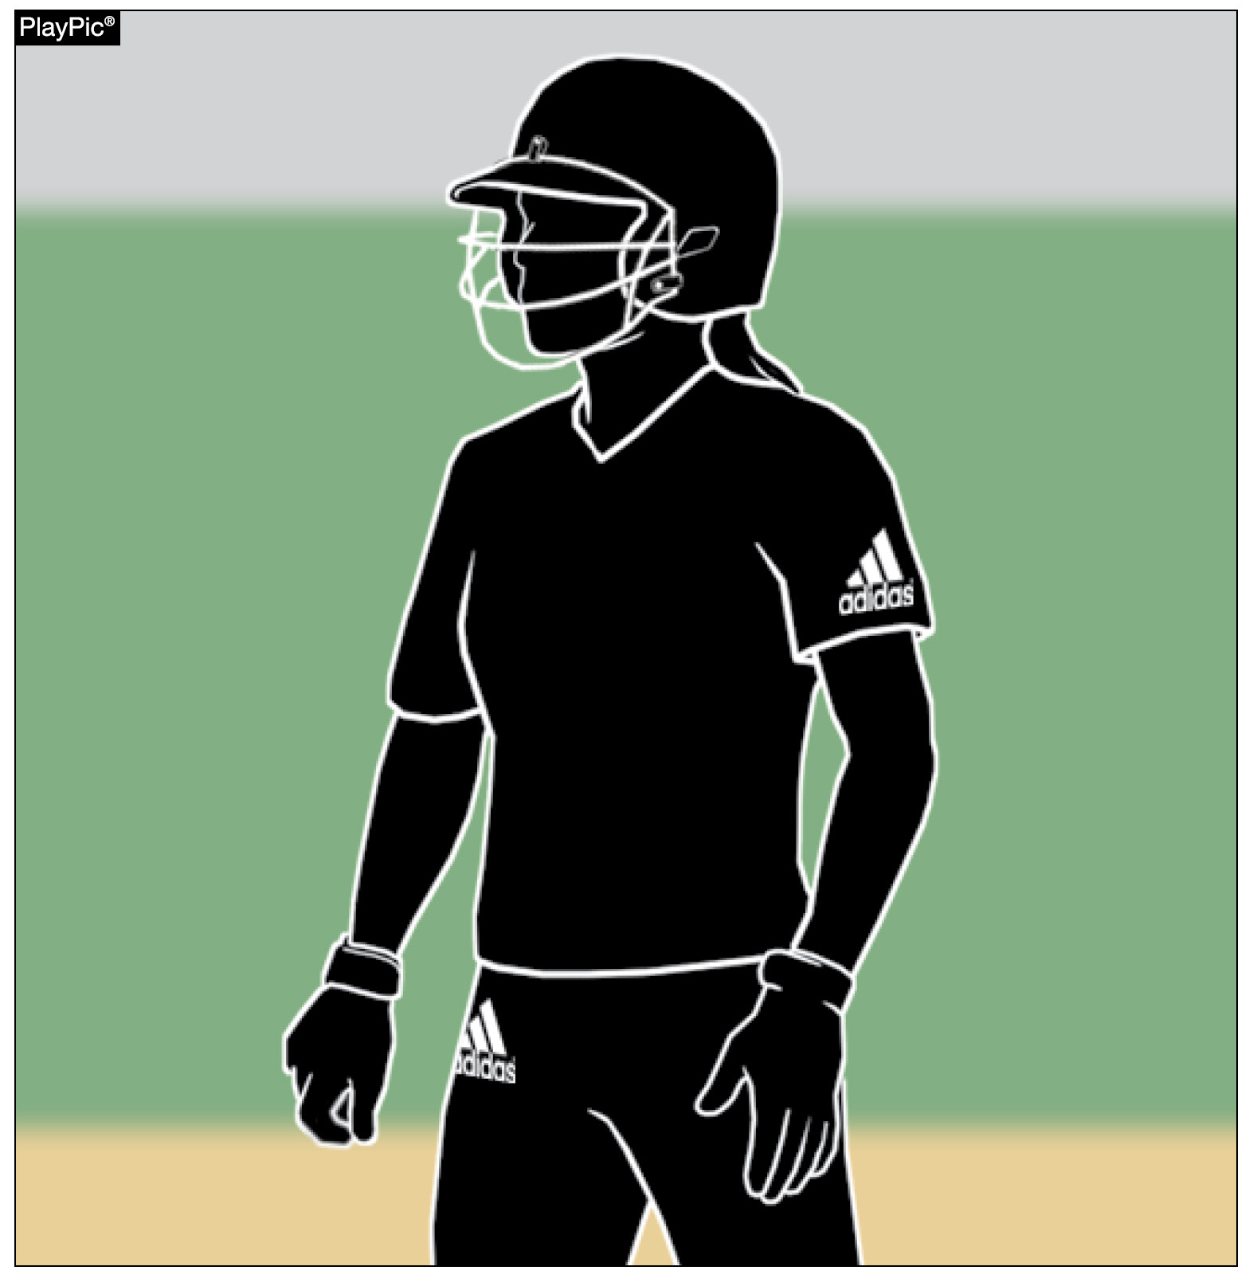
Uniforms, player equipment
3-2-3
Each portion of the school’s official uniform may bear a single manufacturer’s logo/trademark/reference as long as each does not exceed 2 ¼ square inches.
Notes:
Rule 3-2-3: Each portion of the school’s official uniform may bear a single manufacturer’s logo/trademark/reference as long as each does not exceed 2 ¼ square inches.
Rationale: Clarifies requirements for school information on a uniform. Beginning January 1, 2027, uniforms may only bear a single manufacturer’s logo, school, name, school logo, mascot and/or the participant’s name. Advertisements, messages, team slogans, etc., will no longer be allowed. Added language – “on each portion”.

Slide 12
Bench and field conduct, Umpiring
3-6-12, 10-1-6
The rules prohibiting the use of any form of alcohol, illicit substances or tobacco now include participants, coaches, game officials beginning with the arrival at the competition site until departure from the site following the game.
Notes:
Rules 3-6-12, 10-1-6: The rules prohibiting the use of any form of alcohol, illicit substances or tobacco now include participants, coaches, game officials beginning with the arrival at the competition site until departure from the site following the game.
Rationale: Provides consistent language for NFHS rule books prohibiting the use of alcohol, tobacco, and controlled or illicit substances.

Slide 13
Dead ball table
5-1
BALL DEAD IMMEDIATELY
19. Awards or Penalties/References 5-1-1i NOTE, 8-4-3h.
20. References 8-4-3i 8-4-3h, Awards or Penalties/References 8-4-3i 8-4-3j
DELAYED DEAD BALL
1. Awards or Penalties The batter is awarded a ball unless the batter reaches first base safely and
each other runner advances at least one base, the illegal pitch is nullified. Or if the batter does not
reach first base safely or if any base runner fails to advance at least one base, the coach of the
team at bat shall have the option of the result of the play or the penalty of the illegal pitch. The
pitch is ruled a ball if the ball is not hit or batter becomes base runner. Otherwise, if ball is hit and
all runners do not advance one base safely, the team at bat has the choice of accepting the play or
penalty.
2. Awards or Penalties/References 6-4 6-1-4 (S.P.)
Notes:
Rules 5-1 Table:
BALL DEAD IMMEDIATELY
19. Awards or Penalties/References 5-1-1i NOTE, 8-4-3h.
20. References 8-4-3i 8-4-3h, Awards or Penalties/References 8-4-3i 8-4-3j
DELAYED DEAD BALL
1. Awards or Penalties The batter is awarded a ball unless the batter reaches first base safely and each other runner advances at least one base, the illegal pitch is nullified. Or if the batter does not
reach first base safely or if any base runner fails to advance at least one base, the coach of the team at bat shall have the option of the result of the play or the penalty of the illegal pitch. The pitch is ruled a ball if the ball is not hit
or batter becomes base runner. Otherwise, if ball is hit and all runners do not advance one base safely, the team at bat has the choice of accepting the play or penalty.
2. Awards or Penalties/References 6-4 6-1-4 (S.P.)
Rationale: Edits to the Dead Ball Table.

Slide 14
Pitching regulations
6-1-2c
About the pitch:
While pushing off from the pitcher's plate, both feet may be disengaged from the playing surface as long as they remain within the 24-inch length width of the pitcher's plate and do not create a replant of the pivot foot resulting in the pitcher being farther away from the pitcher’s plate. Pushing off with
the pivot foot from a place other than the pitcher's plate resulting in the non-pivot foot becoming closer to home plate is illegal.
Notes:
Rules 6-1-2c: While pushing off from the pitcher's plate, both feet may be disengaged from the playing surface as long as they remain within the 24-inch length width of the pitcher's plate and do not create a replant of the pivot foot resulting in the pitcher being farther away from the pitcher’s plate. Pushing off with the pivot foot from a place other than the pitcher's plate resulting in the non-pivot foot becoming closer to home plate is illegal.
Rationale: Aligns the way the 24-inch pitcher’s plate is described in the rules book.

Slide 15
The batter becomes a batter-Runner
8-1-2a EFFECTS 3
ART. 2 . . . A batter is awarded first base when:
a. fair batted ball strikes the person, attached equipment, or clothing of an umpire or a runner.
3. If before passing a fielder without being touched, the ball is dead. If the runner is hit by the
ball while off base and before it has passed an infielder, excluding the pitcher, or if it passes
an infielder and another fielder has an opportunity to make an out, the runner is out and
the batter-runner is entitled to first base without liability to be put out, and credited with a
fielder's choice. When a fair batted ball touches a runner who is in contact with a base, the
ball is dead or live depending on whether the closest fielder is in front of the base (live) or
behind the base (dead). The runner is not out unless the runner intentionally interferes.
Notes:
Rules 8-1-2a EFFECTS 3: ART. 2 . . . A batter is awarded first base when:
a. fair batted ball strikes the person, attached equipment, or clothing of an umpire or a runner.
3. If before passing a fielder without being touched, the ball is dead. If the runner is hit by the ball while off base and before it has passed an infielder, excluding the pitcher, or if it passes
an infielder and another fielder has an opportunity to make an out, the runner is out and the batter-runner is entitled to first base without liability to be put out, and credited with a
fielder's choice. When a fair batted ball touches a runner who is in contact with a base, the ball is dead or live depending on whether the closest fielder is in front of the base (live) or
behind the base (dead). The runner is not out unless the runner intentionally interferes.
Rationale: To better align these rules with the enforcement in rule 8-6-11 that covers the runner’s actions and provides the direct penalty for their actions.

Slide 16
The runner is out
8-6-4
The runner physically passes a preceding runner before that runner has been put out. If this was the third out of the inning, any runs scoring prior to the out for passing a preceding runner would count. A runner(s) passing a preceding obstructed runner is not out. (8-4-3b PENALTY 3)
Notes:
Rules 8-6-4: ART. 4 . . . The runner physically passes a preceding runner before that runner has been put out. If this was the third out of the inning, any runs scoring prior to the out for passing a preceding runner would count. A runner(s) passing a preceding obstructed runner is not out. (8-4-3b PENALTY 3)
Rationale: Clarifies which penalty applies to Rule 8-6-4.

Slide 17
2025 nfhs softball points of emphasis

Slide 18
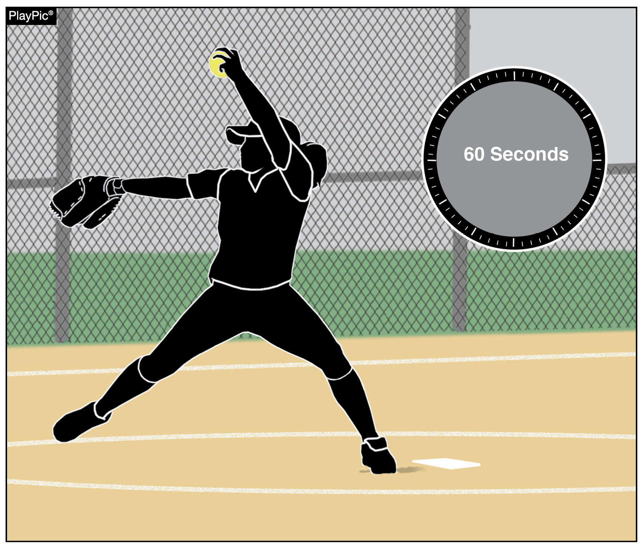
Team’s role in pace of play
There has been a lot of emphasis on pace of play the past several seasons. This year, the focus in on coaches, who play a vital role in creating and maintaining pace-of-play standards.
Between innings, 60 seconds is provided for the defense to take the field and throw warm-up pitches. If the catcher was batting when the inning ended, coaches should have another teammate prepared to receive warm-up pitches.
Notes:
TEAM’S ROLE IN PACE OF PLAY
There has been a lot of emphasis on pace of play the past several seasons. This year, the focus in on coaches, who play a vital role in creating and maintaining pace-of-play standards. Between innings, 60 seconds is provided for the defense to take the field and throw warm-up pitches. If the catcher was batting when the inning ended, coaches should have another teammate prepared to receive warm-up pitches.
Comments: Coaches play a vital role in creating and maintaining pace-of-play standards for their individual players and teams. Every effort should be made to educate players on the rules involved and the timing protocols related to breaks between innings, as well as during gameplay. Between innings, 60 seconds is provided for (a) the defense to take the field and throw warm-up pitches, and (b) the offense to prepare to bat. There are several ways that coaches can expedite this process with simple instructions to players. For example, if the catcher was batting or on base when the third out was made, have another teammate or coach prepared to receive warm-up pitches while the catcher gets equipped.

Slide 19
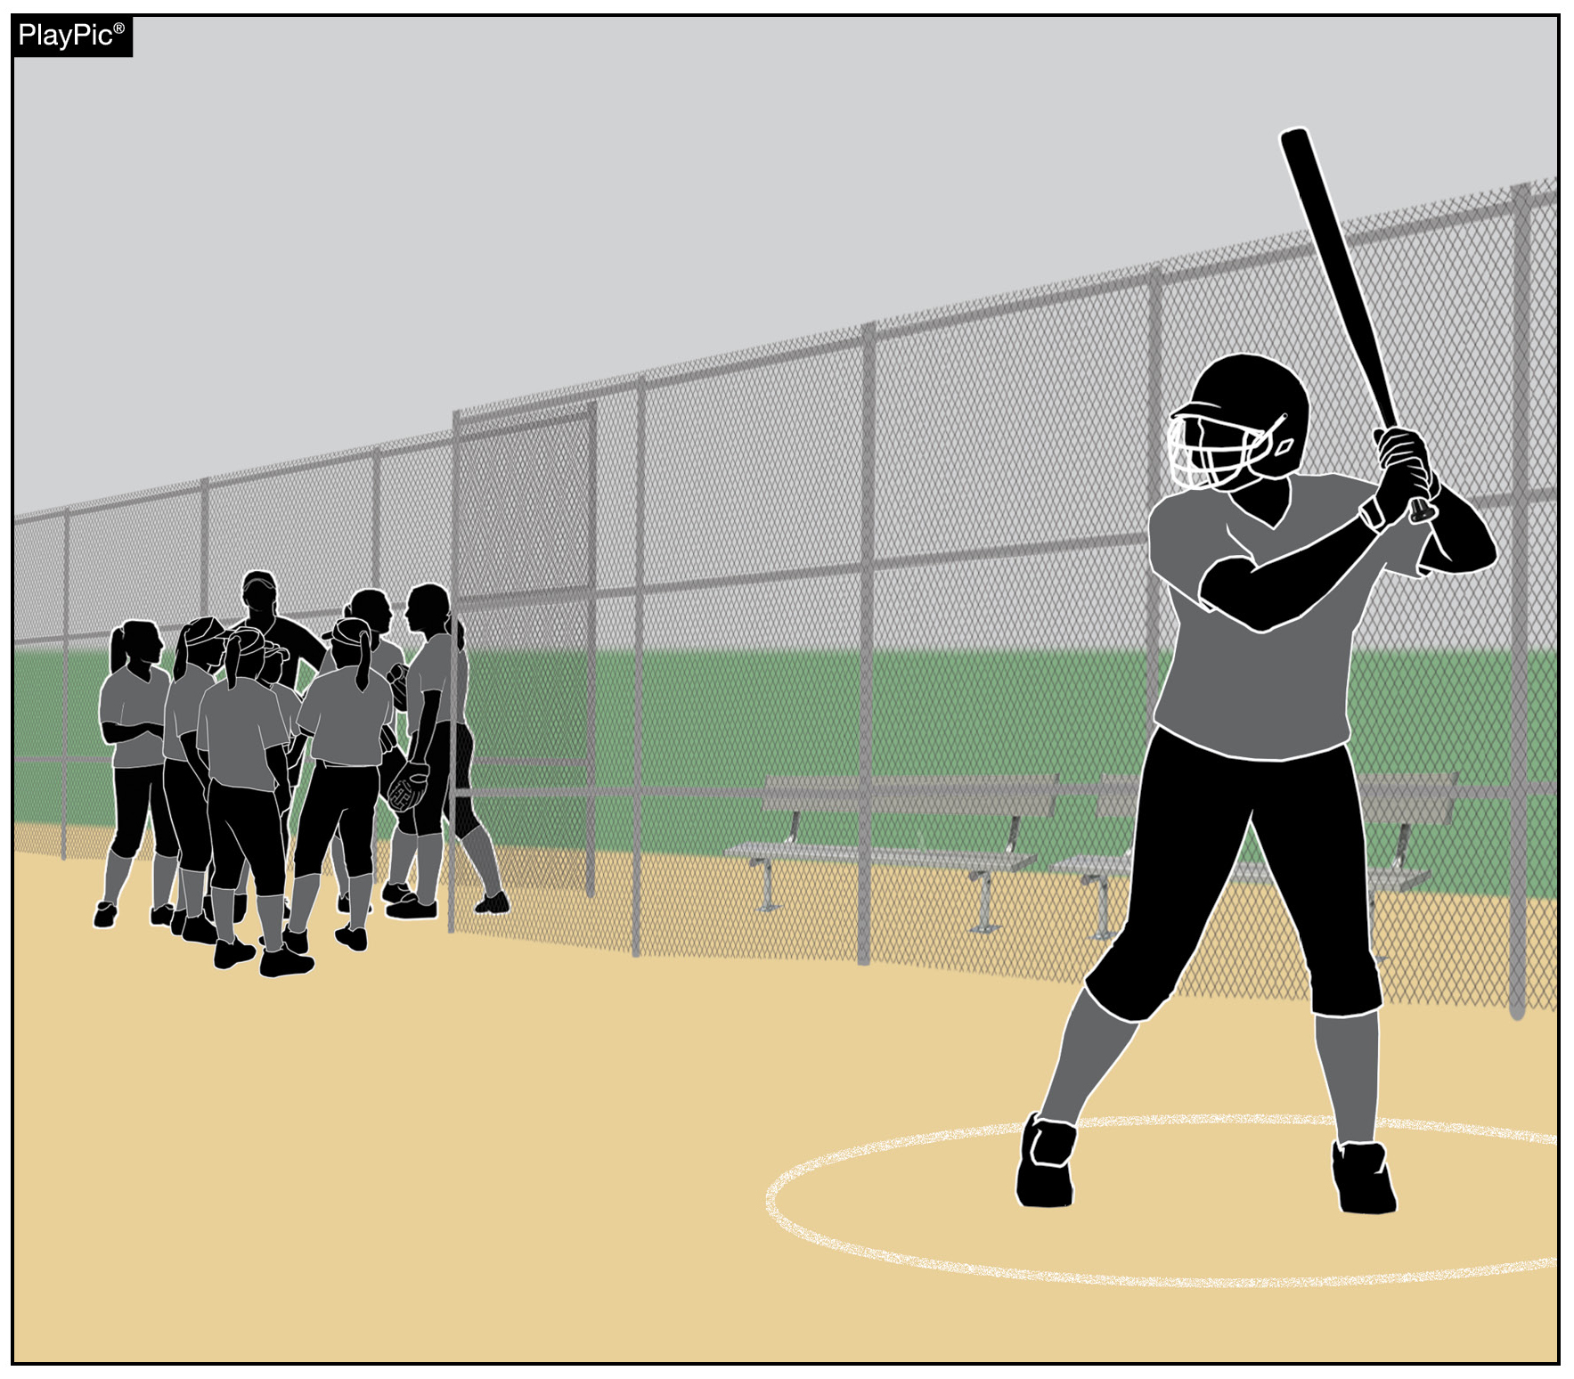
Team’s role in pace of play
The offense also has 60 seconds to prepare to bat. While coaches may choose to huddle with their team as they come off the field, coaches should encourage their lead-off batter to gather their equipment and get ready to bat.
Notes:
TEAM’S ROLE IN PACE OF PLAY
The offense also has 60 seconds to prepare to bat. While coaches may choose to huddle with their team as they come off the field, coaches should encourage their lead-off batter to gather their equipment and get ready to bat.
Comments: For the team coming to bat, coaches should encourage their lead-off batter to gather their batting equipment allowing them to be ready to bat while the remainder of the team huddles in an appropriate area that doesn’t pose a safety risk for the defense warming up.

Slide 20
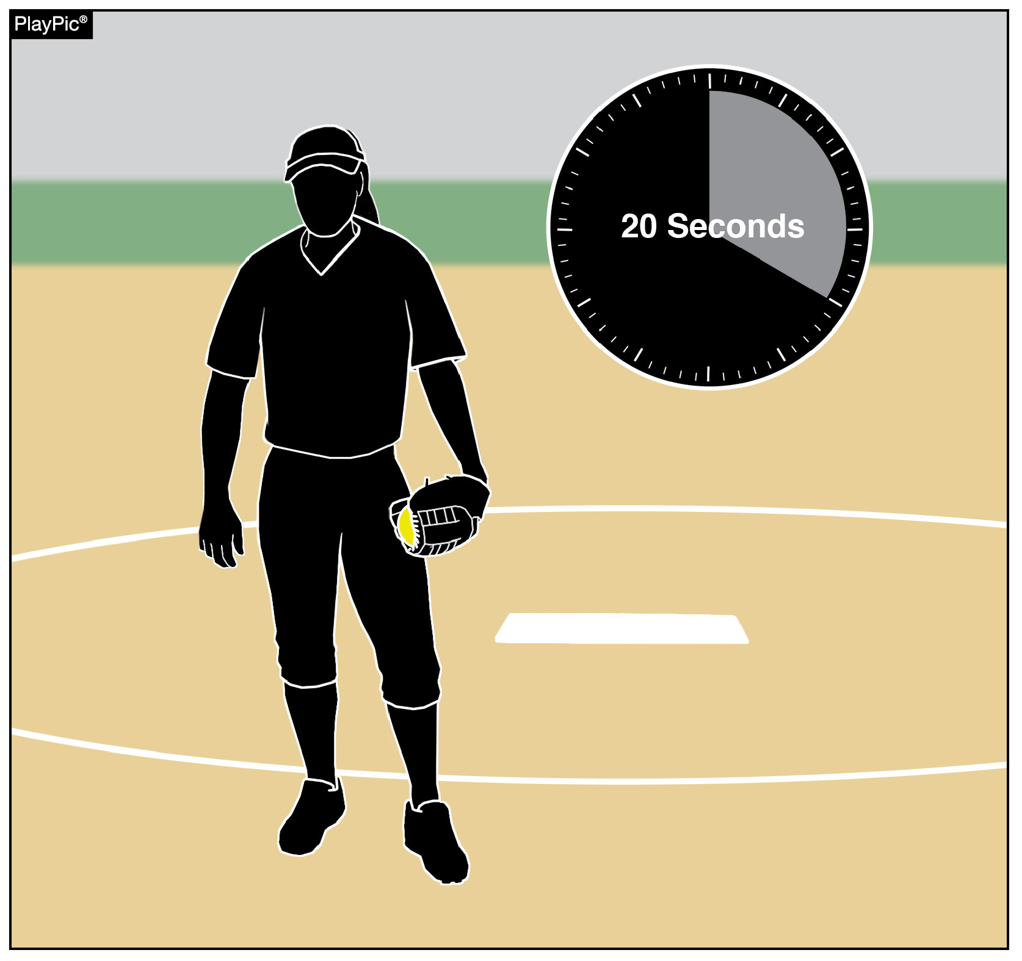
Team’s role in pace of play
Once the 60 seconds between innings has elapsed, the batter has 10 seconds to enter the batter’s box and the pitcher has 20 seconds to legally deliver a pitch.
The pitcher also has 20 seconds to release a pitch once the ball has been returned from a previous pitch and the batter has 10 seconds to enter the batter’s box after the ball is returned.
A ball or strike is added to the count, depending on the tardy party.
Notes:
TEAM’S ROLE IN PACE OF PLAY
Once the 60 seconds between innings has elapsed, the batter has 10 seconds to enter the batter’s box and the pitcher has 20 seconds to legally deliver a pitch. The pitcher also has 20 seconds to release a pitch once the ball has been returned from a previous pitch and the batter has 10 seconds to enter the batter’s box after the ball is returned. A ball or strike is added to the count, depending on the tardy party.
Comments: There are prescribed penalties associated with excessive time between innings. Once the allowed 60 seconds has passed, the offensive team has 10 seconds for its batter to enter the batter’s box (NFHS Rule 7-3-1). Similarly, once the allowed 60 seconds has passed, the pitcher has 20 seconds to legally deliver a pitch (NFHS Rule 6-2-3). These same time constraints exist on each pitch thrown during the game. Once the ball has been returned to the pitcher to prepare for the next pitch, the pitcher has 20 seconds to release the next pitch. Coaches who delay in calling pitches risk a penalty for exceeding the allowed 20 seconds. The same applies to the offense when a batter fails to enter the batter’s box within 10 seconds after the ball is returned to the pitcher. The respective penalties for violations of these time constraints are either a strike or a ball on the batter, depending on the tardy party.

Slide 21
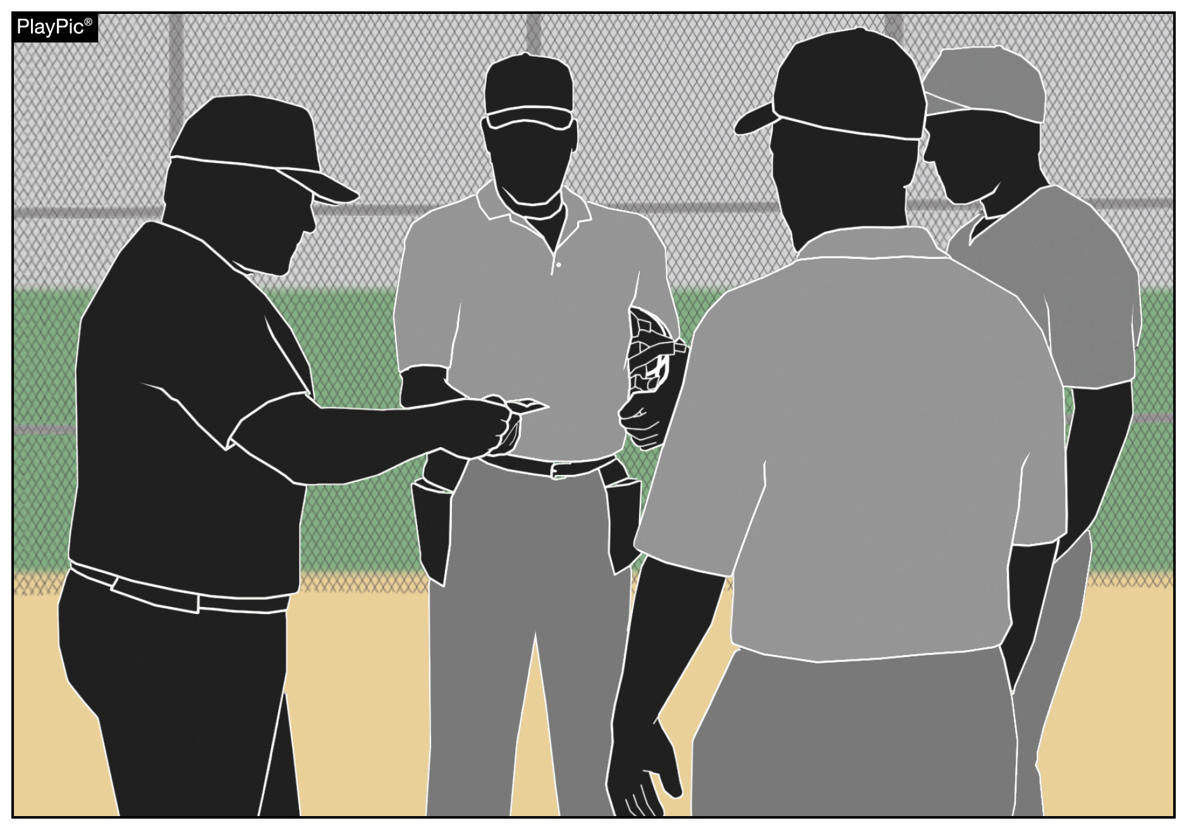
Team’s role in pace of play
Pregame lineup exchanges should be brief and to the point. In order to start games on time, both umpires and coaches should limit talking to pertinent information during this meeting. Remember, this is not meant to be a rules clinic.
Notes:
TEAM’S ROLE IN PACE OF PLAY
Pregame lineup exchanges should be brief and to the point. In order to start games on time, both umpires and coaches should limit talking to pertinent information during this meeting. Remember, this is not meant to be a rules clinic.
Comments: And finally, pregame lineup exchanges should be brief and to the point. In order to start games on time, both umpires and coaches should limit talking to pertinent information during this meeting. Although it is important for all to be on the same page especially concerning any specific ground rules, this is not meant to be a rules clinic.

Slide 22
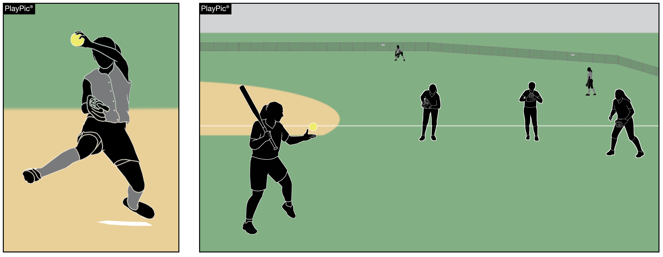
Situational awareness
The safety of all participants is a priority for all involved in game management. All bench and field conduct rules must be enforced, including not allowing the hitting of balls to teammates on defense once the game begins.
Notes:
SITUATIONAL AWARENESS
The safety of all participants is a priority for all involved in game management. All bench and field conduct rules must be enforced, including not allowing the hitting of balls to teammates on defense once the game begins.
Comments: Participant well-being should be a priority for all those involved in game management. Coaches and umpires can help minimize risk and injury to players by understanding and enforcing existing bench and field conduct rules. NFHS rules stipulate that once the game has begun, only the batter, runner(s), on-deck batter, coaches in the coach’s box, bat/ball shaggers or one of the nine players on defense are permitted to be outside the designated dugout/bench or designated warm-up areas (i.e. batting cage or bullpen). Additionally, during game play, hitting the ball to teammates on defense is prohibited.

Slide 23
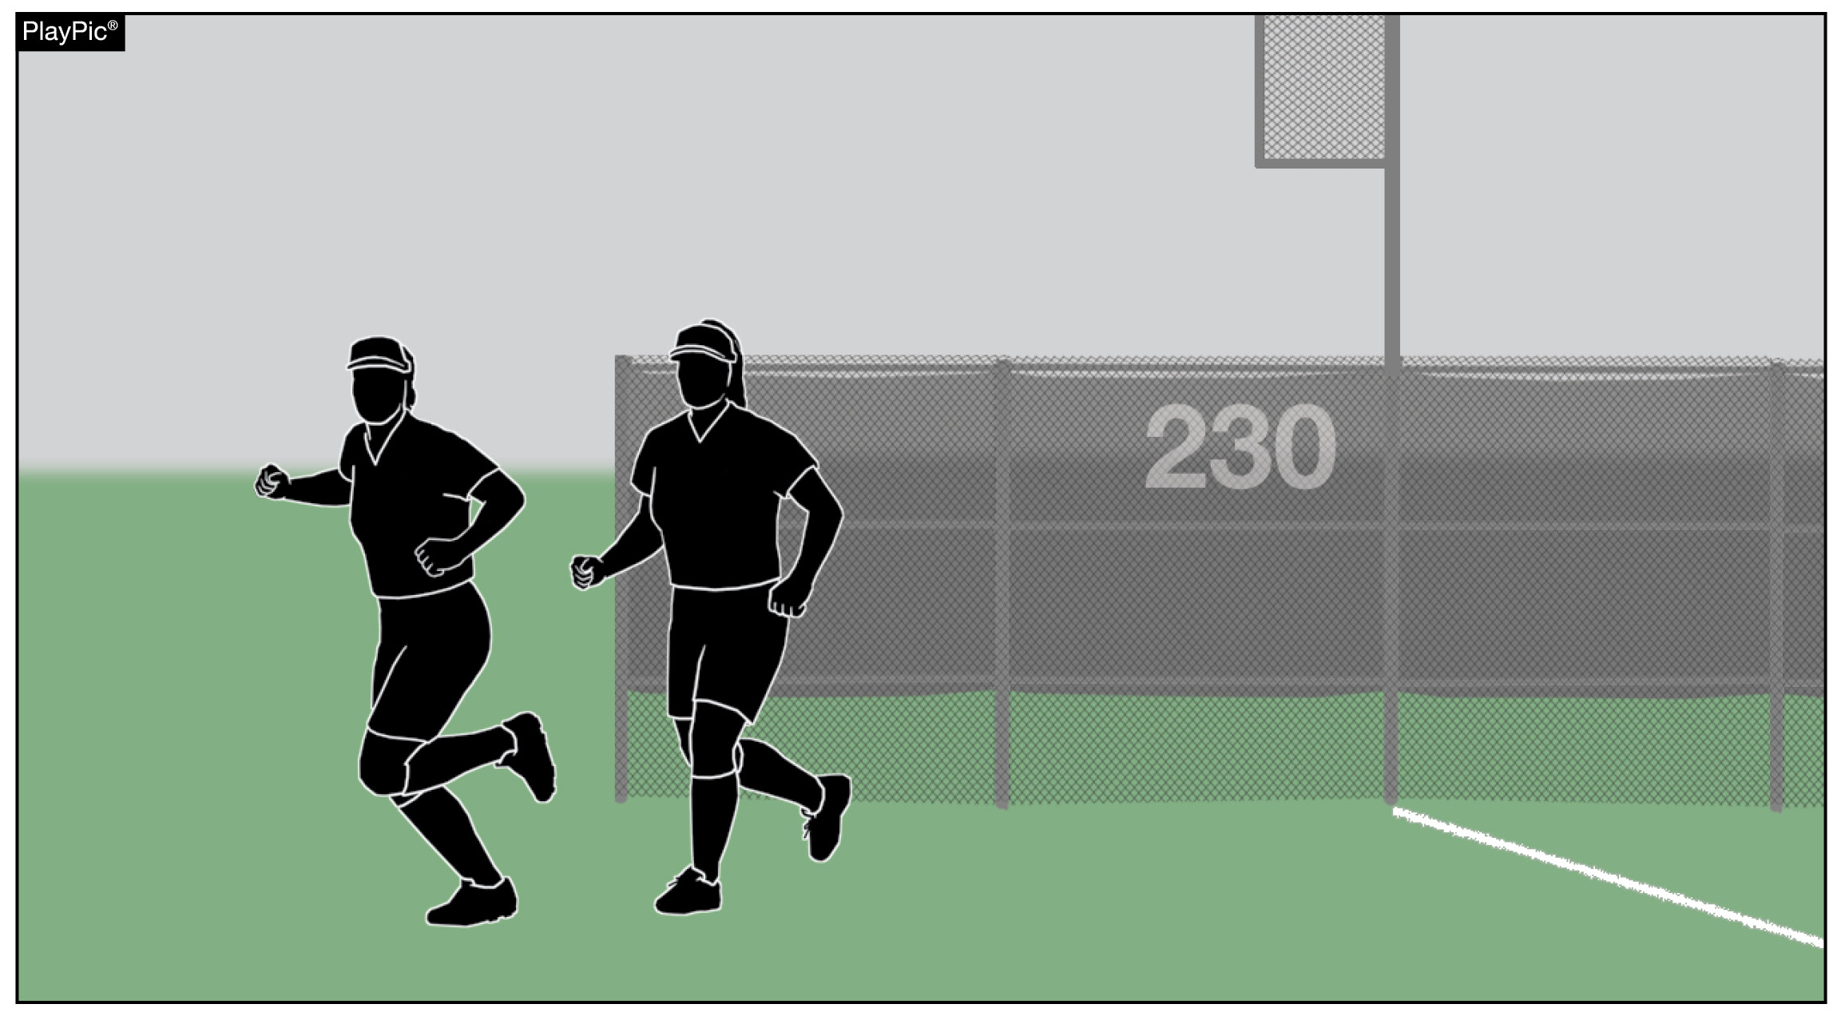
Situational awareness
Between innings, bench personnel are permitted to engage in throwing and running activities.
Notes:
SITUATIONAL AWARENESS
Between innings, bench personnel are permitted to engage in throwing and running activities.
Comments: During the 60 seconds allowed between innings bench personnel are allowed to participate in throwing or running activities. Care should be taken to perform these activities in a manner that minimizes risk to all participants.

Slide 24
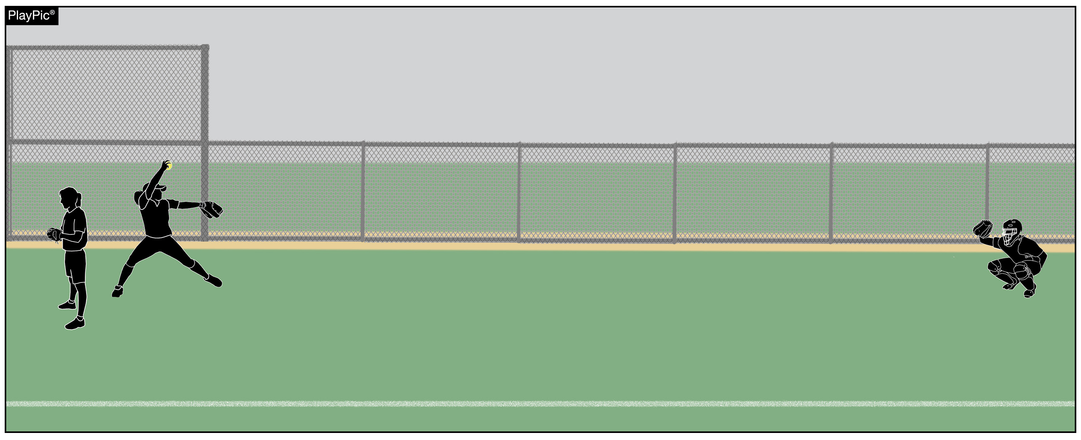
Situational awareness
If a bullpen is in an area where a foul ball or overthrow could contact a pitcher or catcher, the team should assign bench personnel with a glove to stand nearby to shield those warming up.
Notes:
SITUATIONAL AWARENESS
If a bullpen is in an area where a foul ball or overthrow could contact a pitcher or catcher, the team should assign bench personnel with a glove to stand nearby to shield those warming up.
Comments: Field structure and dugout protection vary from facility to facility. Team personnel should assess and be aware of potential hazards associated with foul balls and overthrows. For example, if a bullpen is in an area where a foul ball or overthrow could contact the pitcher or catcher, the team might assign bench personnel with a glove to stand nearby to shield those warming up.

Slide 25
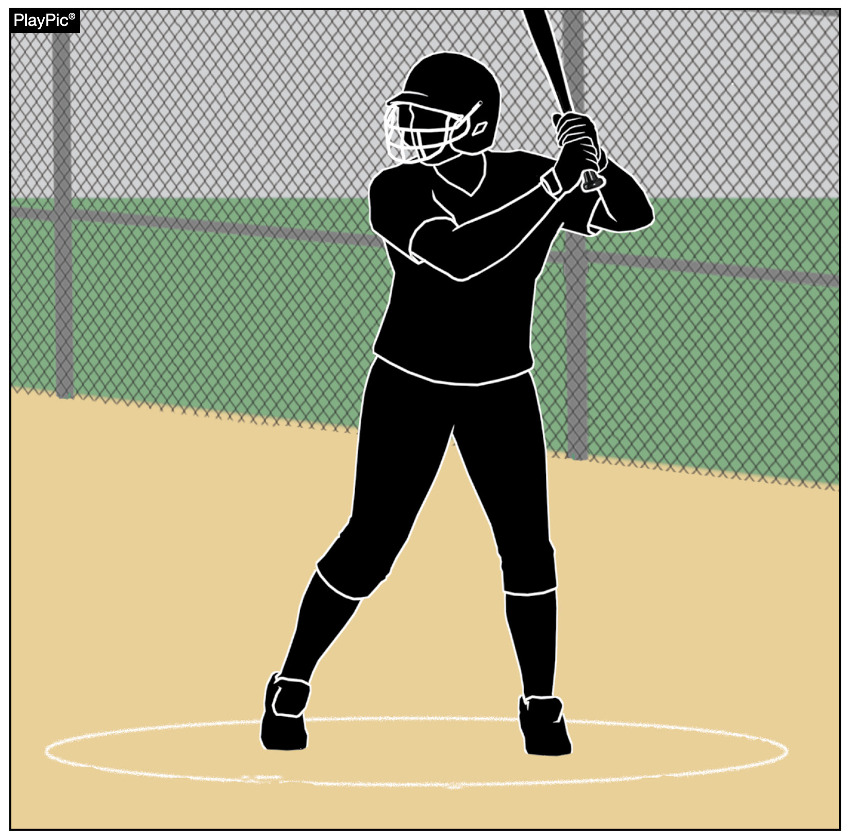
Situational awareness
On-deck batters should be aware of potential foul balls and overthrows and be prepared to move as necessary to avoid contact.
By rule, on-deck batters MUST use the on-deck circle closest to their own dugout.
Notes:
SITUATIONAL AWARENESS
On-deck batters should be aware of potential foul balls and overthrows and be prepared to move as necessary to avoid contact. By rule, on-deck batters MUST use the on-deck circle closest to their own dugout.
Comments: On-deck batters should be mindful of potential foul balls and overthrows and be prepared to move as necessary to avoid contact. On-deck batters must use the on-deck circle closest to their own dugout.

Slide 26
Nfhs Authentication Mark Update

Slide 27



NFHS Authenticating Mark update
Specifications
Do not use the NFHS Authenticating Mark without prior written approval from the NFHS
This mark is for use of licensees only.
Minimum size
  Inflatable Balls - 2 ½" (Basketball, Football, Soccer, Volleyball, and Water Polo)
  Non-Inflatable Balls - 1 ¼" (Baseball, Field Hockey, Ice Hockey Puck, Lacrosse, and Softball)
  On a ball or puck, the NFHS logo may be smaller than manufacturer’s logo, but should be placed in proximity to the manufacturer’s name for easy identification. Allow enough space around the logo so it can be easily recognized as distinct and separate.
  Reproduce the logo only from the vector artwork provided here or on Direct Licensing Hub. Do not copy, scan art electronically or use as a template to redraw the symbol.
Note: If sizing or specifications do not work well in your particular design situation, contactK12 Licensing.
Current Logos
New Logo
Notes:
Effective January 16, 2024, the NFHS has phased out the use of the old NFHS mark on ball/puck applications. Any remaining on hand inventory with the old NFHS mark will be saleable until inventory is depleted and schools will be able to use inventory with the old NFHS mark until the equipment is retired. All NFHS AMP certified manufacturers are required to utilize the updated NFHS mark on all new produced and certified inflated and non-inflated balls moving forward.

Slide 28
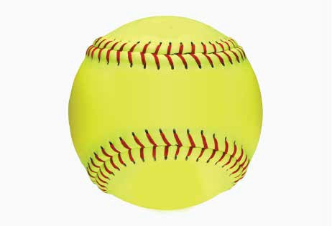


Softball
Old Size
Current Size
OR
1.25”

Slide 29

Thank You
National Federation of State High School Associations
PO Box 690 | Indianapolis, IN 46206
Phone: 317-972-6900
www.nfhs.org | www.nfhslearn.com | www.nfhsnetwork.com

