Slide 1
2024-25 nfhs water polo RULES CHANGES

Slide 2
MARKERS
1-6-1e (NEW)
A continuous red marking must be placed on the goal line, 2 meters from the outside of both goal posts. An imaginary line from the end of each red markings to the 2-meter line creates the “goal area”.
Examples of red markings could include red buoys from 2 meters outside of the cage, red tape around one buoy, red cones on side of pool, red tape/red paint used for marking.
Notes:
Rule 1-6-1e (NEW):
A continuous red marking must be placed on the goal line, 2 meters from the outside of both goal posts. An imaginary line from the end of each red markings to the 2-meter line creates the “goal area”.
Examples of red markings could include red buoys from 2 meters outside of the cage, red tape around one buoy, red cones on side of pool, red tape/red paint used for marking
Rationale: Clarifies the new goal area.
Comments: Defines the markings for the new goal area rule. The requirement for new markings delineating the goal area can be implemented in a variety of ways. For floating goals, temporary markings such as red tape, red paint, red foam markers, or a red towel tied on the goal line lane line at a distance of 2 meters outside of each goal post can be used. For wall goals, a cone on the deck and/or red tape or red paint 2 meters outside of each goal post will be acceptable as temporary markers. For floating goals, markings will include continuous red buoys on the goal line lane line for a distance of 2 meters outside of each goal post. For wall goals, the continuous marking can be placed using red deck edge markers.

Slide 3
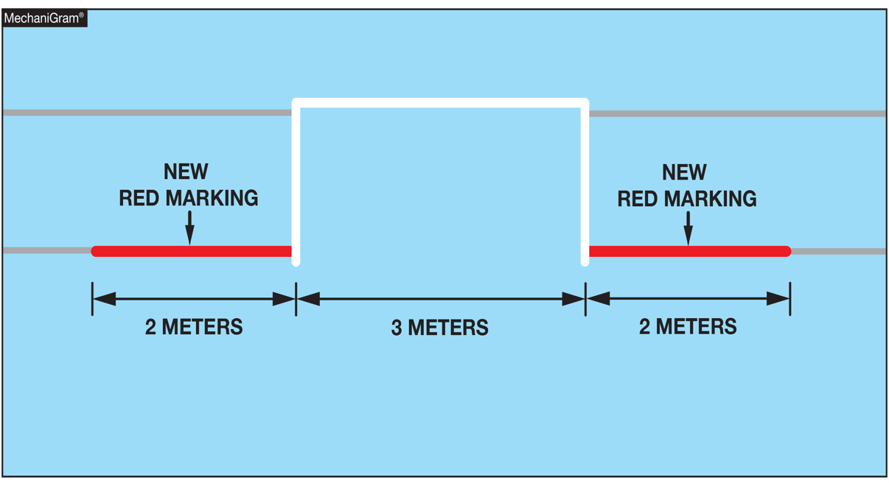
MARKERS
1-6-1e (NEW)
Notes:
1-6-1e: A continuous red marking must be placed on the goal line, 2 meters from the outside of both goal posts. An imaginary line from the end of each red markings to the 2-meter line creates the “goal area”.
Rationale: Clarifies the new goal area. Examples of red markings could include red buoys from 2 meters outside of the cage, red tape around one buoy, red cones on side of pool, red tape/red paint used for marking.

Slide 4
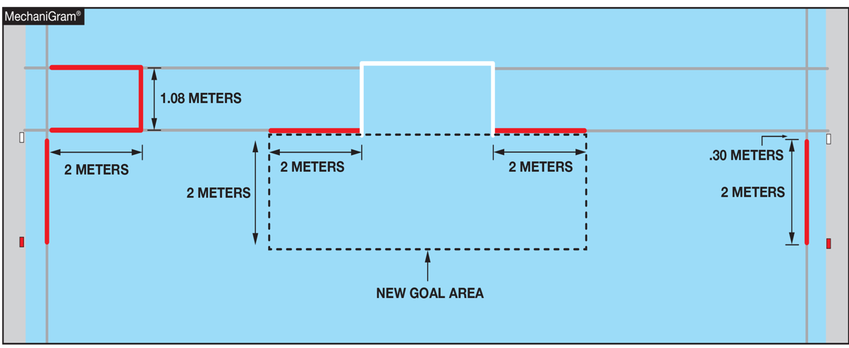
MARKERS
1-6-1e (NEW)
Notes:
1-6-1e: A continuous red marking must be placed on the goal line, 2 meters from the outside of both goal posts. An imaginary line from the end of each red markings to the 2-meter line creates the “goal area”.
Rationale: Clarifies the new goal area. Examples of red markings include red buoys from 2 meters outside of the cage, red tape around one buoy, red cones on side of pool, red tape/red paint used for marking

Slide 5
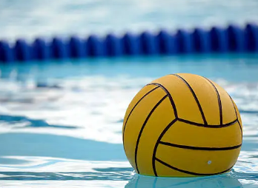
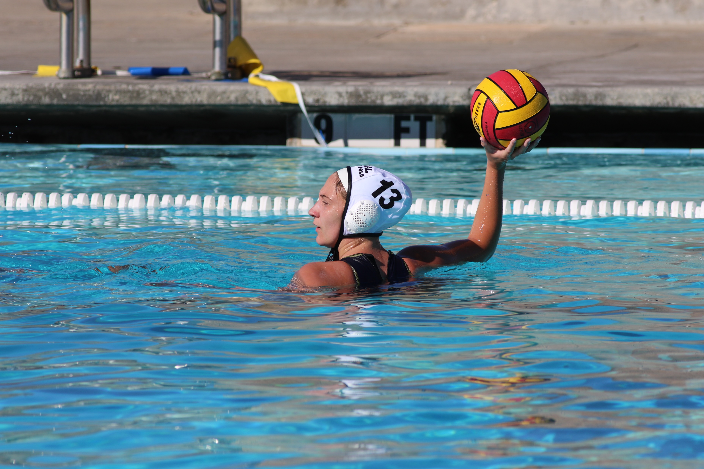

Ball description
1-16
Removed the color restriction for the ball requiring yellow or gold. The ball must be of a color that contrasts with the colors of the players' caps and is clearly and safely visible.
Notes:
Rule 1-16:
The ball shall be round and have the traditional 18 panels. It shall have an air chamber with a self-closing valve. It shall be waterproof, without external strappings or any covering of grease or similar substance. The colored panels must be as manufactured (not hand-painted). The ball must be of a color that contrasts with the colors of the players’ caps and is clearly and safely visible. (1-25, 3-9)
Rationale: Ball coloring has changed over the years and predominantly yellow panels can be difficult to see in a stadium or under night lighting. The change gives a team the ability to choose a ball suitable for its team’s conditions, especially under night lighting.
Comments: Allows teams to use different colored game balls as long as they contrast with the colors of the players caps and can clearly be seen. If a game ball is deemed “illegal” by the game officials, a different set of game balls will be used. If no other colored balls are available, the game should be played, and the official should report the violation to respective state association.

Slide 6
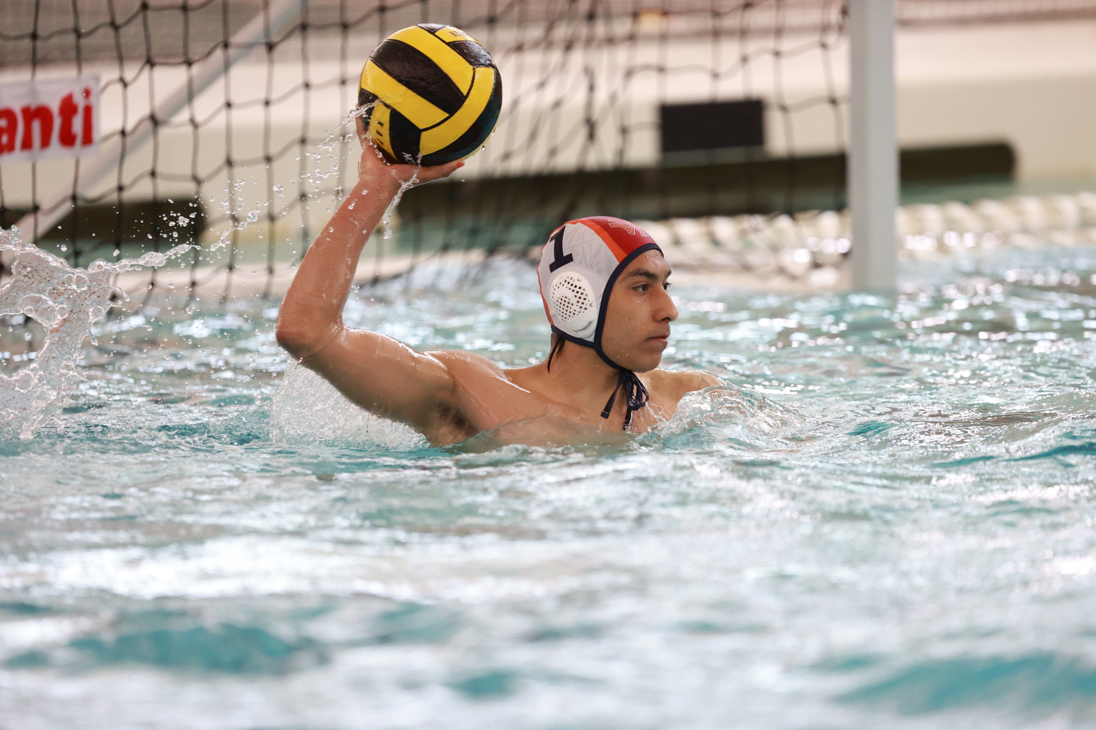
Teams and substitutes
2-1-2
Defined an illegal player as one who enters the game during live play wearing an additional goalkeeper’s cap.
Notes:
Rule 2-1-2:
Defined an illegal player as one who enters the game during live play wearing an additional goalkeeper’s cap.
Rationale: Clarifies the definition of an illegal player. During live play only one player wearing a goalie cap is allowed in the field of play.
Comments: Previously, there was nothing in the rules book that specified what the penalty would be if a second player wearing a goalkeeper cap enters the game during live play. This new rule clarifies that a player wearing a second goalkeeper cap who enters the game during live time is considered an illegal player. The player would be excluded for the remainder of the game and a penalty throw would be awarded to the opposing team with the substitute for the excluded player in the re-entry area. This penalty would be the same whether the offending player’s team is on offense or defense.

Slide 7
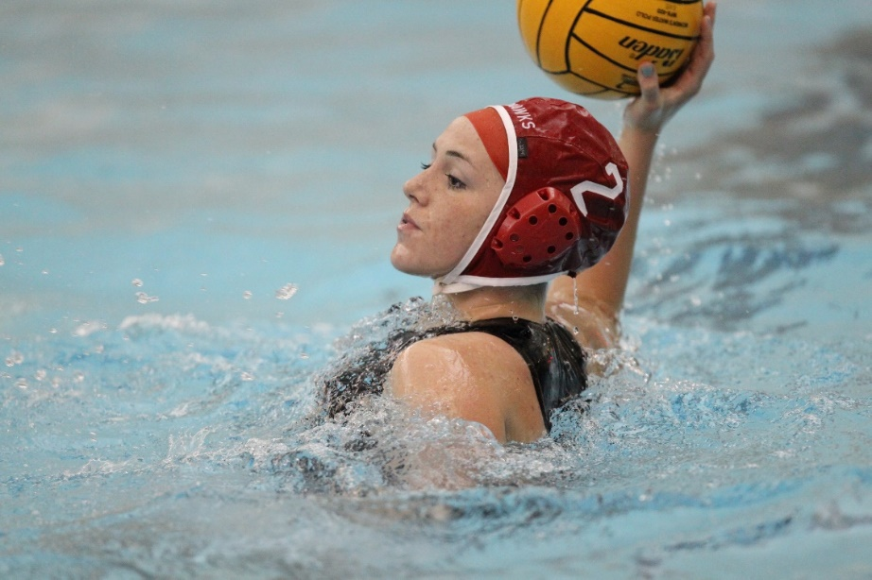
Game timer duties
3-17-2a
Added the phrase “or gains possession of” to the rule, which will assist referees and timekeepers in the case where a player wins an uncontested sprint but does not touch the ball.
Notes:
Rule 3-17-2a:
Added the phrase “or gains possession of” to the rule, which will assist referees and timekeepers in the case where a player wins an uncontested sprint but does not touch the ball.
Rationale: This addition allows referees to consider that possession has been gained and the clock can start.
Comments: By adding “or gains possession of” to the rule, it assists referees and timekeepers in the case where a player wins an uncontested sprint but does not touch the ball. This addition allows referees to consider that possession has been gained and the clock can start.

Slide 8
Goals – how scored
4-22 NOTE (NEW)
Added a note defining a goal can be scored directly on a corner throw after the referee has removed the ball from the water for an administrative issue:
NOTE: This includes after a correctable clock error and after the
referee has removed the ball from the water prior to a corner
throw for instance such as replacement of a cap or zipping
up a suit.
Notes:
Rule 4-22 NOTE:
Added a NOTE defining a goal can be scored directly on a corner throw after the referee has removed the ball from the water for an administrative issue:
NOTE: This includes after a correctable clock error and after the referee has removed the ball from the water prior to a corner throw for instance such as replacement of a cap or zipping up a suit.
Rationale: A team entitled to a direct shot should not be affected by an error in which they aren’t involved or a referee’s choice in timing to correct a uniform issue.
Comments: The previous rule limited the direct shot on a corner throw when the ball is removed prior to the throw only for correction of a clock error, replacement of a cap, or the zipping up of a suit. Because there is usually no offensive advantage prior to a corner throw, that time is often well suited for use by the officials for other administrative reasons, such as addressing an issue at the desk or a clock question. The new language will provide administrative flexibility for the officials by allowing a direct shot if the ball is removed for any administrative reason prior to the taking of a corner throw.

Slide 9
Section 10 Free throws – where taken
5-10-1
A free throw shall be taken at the location of the ball except:
if the foul is committed by a defending player within the
defender’s goal area, the free throw shall be taken outside the
goal area, opposite of the ball or laterally outside the goal area
toward the sideline.
Notes:
Rule 5-10-1:
A free throw shall be taken at the location of the ball except if the foul is committed by a defending player within the defender’s goal area, the free throw shall be taken outside the goal area, opposite of the ball or laterally outside the goal area toward the sideline.
Rationale: Clarifies that the attacking player no longer needs to be outside the defending 2-meter area to take the free throw. As long as the player exits the new goal area, they can take the free throw.
Comments: If the foul is committed inside the 2-meter area but outside of the goal area, the free throw is taken where the ball is. The player does not need to move outside 2 meters to take the free throw. If the foul is inside the goal area, the free throw can be taken outside the goal area opposite the ball (toward half pool) or laterally outside the goal area (toward the sideline).

Slide 10
free throws – time allowed
5-11 NOTE (NEW)
NOTE: When there is a counterattack, a player with a position of advantage does not have to give up the advantage to go to the ball and take the free throw. The player on that team who is next closest to the ball must take the free throw as long as there is no undue delay.
Notes:
Rule 5-11 NOTE:
NOTE: When there is a counterattack, a player with a position of advantage does not have to give up the advantage to go to the ball and take the free throw. The player on that team who is next closest to the ball must take the free throw as long as there is no undue delay.
Rationale: This note formalizes something that has been informally accepted as common practice for many years, i.e., that a player in a counterattack with a position of advantage should not be required to go toward their own goal or toward the sideline to take a free throw and give up the advantage simply because that player is closest to the ball. Instead, the player who is next to the ball when the ball is awarded to the defense or who swims past the ball on a counterattack and does not put the ball into play would be called for undue delay in taking the free throw. Makes the game faster and does not punish the team that has an advantage on the counterattack.
Comment: If there is no advantage on the counterattack, the player most readily available to take the free throw must do so.

Slide 11
inside the goal area
6-11-1, 6-11-2
Changes the specific area around the goal and allows for an attacking player who is outside the goal area to go inside 2 meters without being penalized.
Referees should not penalize an attacking player who momentarily enters the goal area without interfering with the play. If an attacking player, who remains in the goal area can affect defensive actions, the foul should be called.
Notes:
Rules 6-11-1, 6-11-2:
Changes the specific area around the goal and allows for an attacking player who is outside the goal area to go inside 2 meters without being penalized.
Changes the specific area around the goal and allows for an attacking player who is outside the goal area to go inside 2 meters without being penalized.
Rationale: This rule changes the specific area around the goal. This rule allows for an attacking player who is outside the goal area to go inside 2 meters without being penalized. This opens up more angles for the offense and does not unnecessarily punish an attacking player who is not close enough to the goal but enters the 2-meter area.
Comments: The rule change opens up more angles for the offense and gives the officials less to watch when a player may be inside the 2-meter mark while not directly impacting the play. It also opens up the game from an offensive standpoint creating more room for the offense to move around in and extending the defense.

Slide 12
Inside goal area
6-11-3 (new)
Clarifies that a player in the goal area of the attacking team can never be in front of the line of the ball at any time during the game.
A player in the goal area of the attacking team can never be in front of the line of the ball at any time during the game. If a pass within the goal area flies forward (toward the goal line) ahead of the receiving player(s), an ordinary foul (contra foul) must be called, even if the two attacking players were at the same line at the moment of the pass. This is especially important to apply in a player advantage situation.
Notes:
Rule 6-11-3:
Clarifies that a player in the goal area of the attacking team can never be in front of the line of the ball at any time during the game.
A player in the goal area of the attacking team can never be in front of the line of the ball at any time during the game. If a pass within the goal area flies forward (toward the goal line) ahead of the receiving player(s), an ordinary foul (contra foul) must be called, even if the two attacking players were at the same line at the moment of the pass. This is especially important to apply in a player advantage situation.
Rationale: The pass to a player inside the goal area must be on a straight line or behind. This rule also assists referees to correctly call “inside the goal area” violations. It makes the rule more clear for a play that is so close to the goal that can be scored easily.
Comments: Previously, there was a high probability that “inside 2-meter” violations would be missed and lead to goals due to the receiving player being ahead of the ball. Because the new goal area is the area closest to the goal, this new rule allows the officials to correctly call “inside the goal area” violations when the receiving player is ahead of the ball. Once the official sees the ball fly forward (toward the attacking goal) to a player inside the goal area or to a player who will receive the ball inside the goal area, it is a violation. The pass must be on a straight line even with the receiving player or thrown behind.

Slide 13
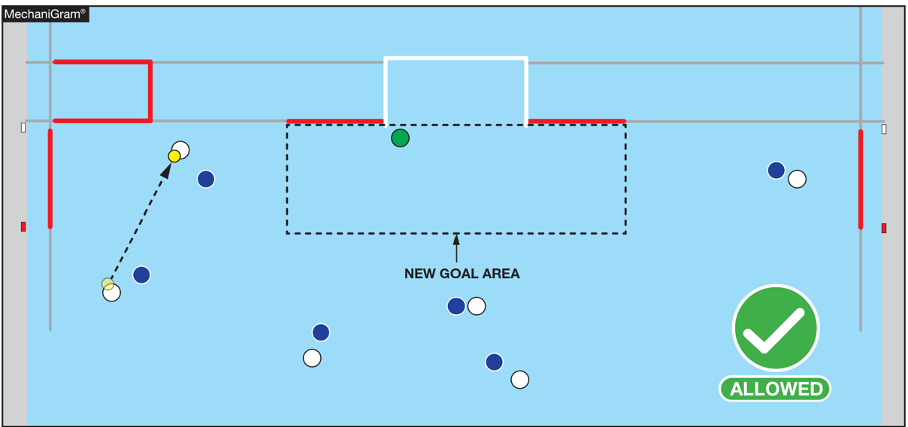
the attacker is Outside the goal area: allowed
Notes:
Rule 6-11-3:
A player in the goal area of the attacking team can never be in front of the line of the ball at any time during the game. If a pass within the goal area flies forward (toward the goal line) ahead of the receiving player(s), an ordinary foul (contra foul) must be called, even if the two attacking players were at the same line at the moment of the pass. This is especially important to apply in a player advantage situation.
Rationale: The pass to a player inside the goal area must be on a straight line or behind. This rule also assists referees to correctly call “inside the goal area” violations. It makes the rule more clear for a play that is so close to the goal that can be scored easily.

Slide 14
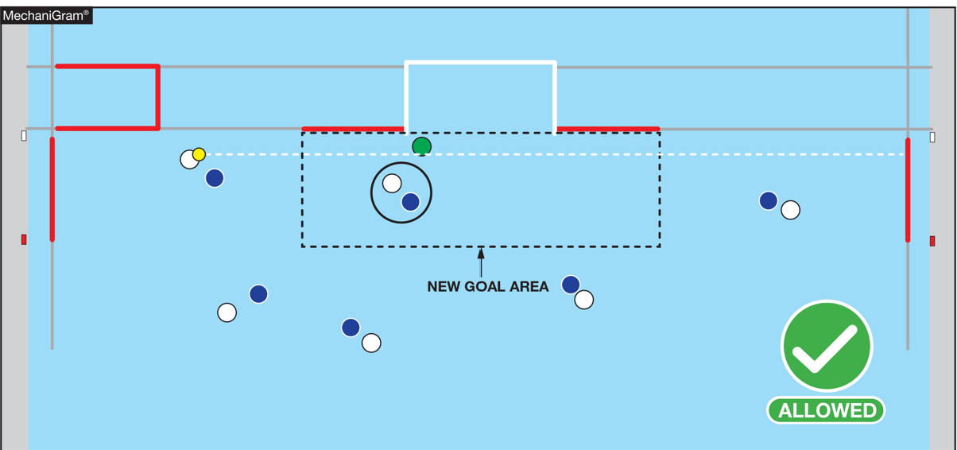
The attacker is inside the goal but behind the line of the ball: allowed
Notes:
Rule 6-11-3:
A player in the goal area of the attacking team can never be in front of the line of the ball at any time during the game. If a pass within the goal area flies forward (toward the goal line) ahead of the receiving player(s), an ordinary foul (contra foul) must be called, even if the two attacking players were at the same line at the moment of the pass. This is especially important to apply in a player advantage situation.
Rationale: The pass to a player inside the goal area must be on a straight line or behind. This rule also assists referees to correctly call “inside the goal area” violations. It makes the rule more clear for a play that is so close to the goal that can be scored easily.

Slide 15
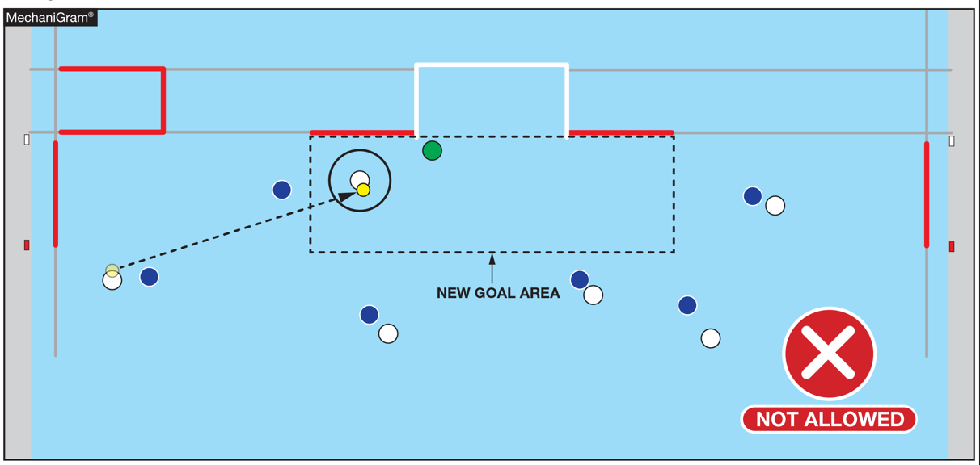
the attacker is inside the goal area: not allowed
Notes:
Rule 6-11-3:
A player in the goal area of the attacking team can never be in front of the line of the ball at any time during the game. If a pass within the goal area flies forward (toward the goal line) ahead of the receiving player(s), an ordinary foul (contra foul) must be called, even if the two attacking players were at the same line at the moment of the pass. This is especially important to apply in a player advantage situation.
Rationale: The pass to a player inside the goal area must be on a straight line or behind. This rule also assists referees to correctly call “inside the goal area” violations. It makes the rule more clear for a play that is so close to the goal that can be scored easily.

Slide 16
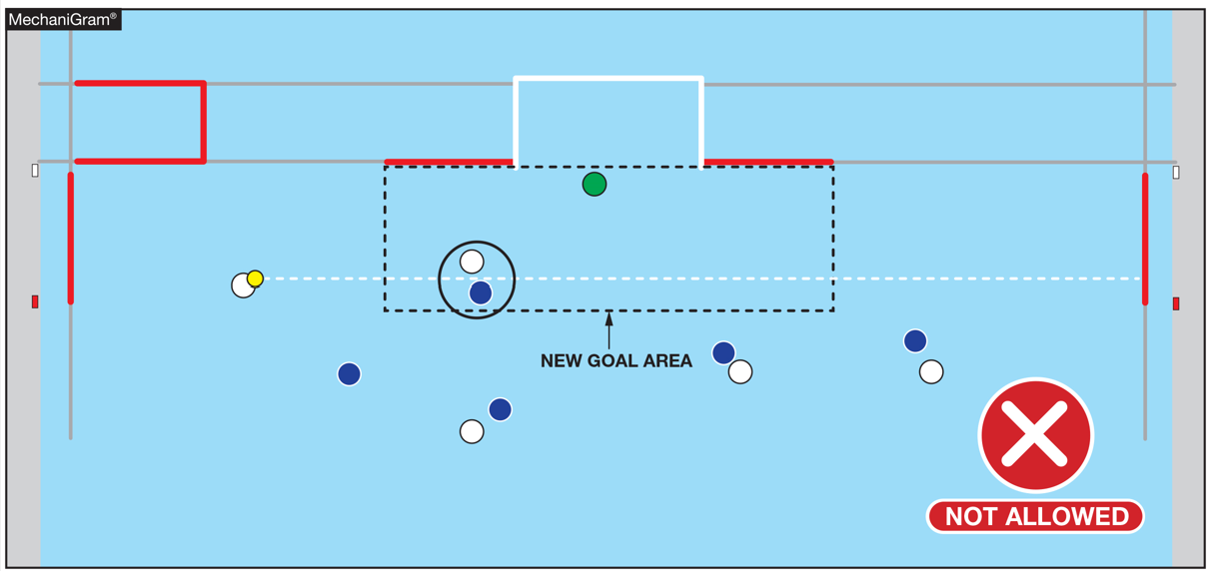
the attacker is inside the goal area and in front of the line of the ball: not allowed
Notes:
Rule 6-11-3:
A player in the goal area of the attacking team can never be in front of the line of the ball at any time during the game. If a pass within the goal area flies forward (toward the goal line) ahead of the receiving player(s), an ordinary foul (contra foul) must be called, even if the two attacking players were at the same line at the moment of the pass. This is especially important to apply in a player advantage situation.
Rationale: The pass to a player inside the goal area must be on a straight line or behind. This rule also assists referees to correctly call “inside the goal area” violations. It makes the rule more clear for a play that is so close to the goal that can be scored easily.

Slide 17
2024-26 nfhs water polo major editorial CHANGES

Slide 18
Editorial changes
NOTE
No participant, team personnel coach, administrator or contest official shall use any form of alcohol or tobacco or be under the influence of (i.e. impaired by) a controlled or illicit substance(s) beginning with arrival at the competition site until departure following the completion of the contest.
Notes:
NOTE: No participant, team personnel coach, administrator or contest official shall use any form of alcohol or tobacco or be under the influence of (i.e. impaired by) a controlled or illicit substance(s) beginning with arrival at the competition site until departure following the completion of the contest.
Rationale: Provides consistent language for NFHS rule books prohibiting the use of alcohol, tobacco, and controlled or illicit substances.

Slide 19



NFHS Authenticating Mark update
1-19-3
Specifications
Do not use the NFHS Authenticating Mark without prior written approval from the NFHS
This mark is for use of licensees only.
Minimum size
  Inflatable Balls - 2 ½" (Basketball, Football, Soccer, Volleyball, and Water Polo)
  Non-Inflatable Balls - 1 ¼" (Baseball, Field Hockey, Ice Hockey Puck, Lacrosse, and Softball)
  On a ball or puck, the NFHS logo may be smaller than manufacturer’s logo, but should be placed in proximity to the manufacturer’s name for easy identification. Allow enough space around the logo so it can be easily recognized as distinct and separate.
  Reproduce the logo only from the vector artwork provided here or on Direct Licensing Hub. Do not copy, scan art electronically or use as a template to redraw the symbol.
Note: If sizing or specifications do not work well in your particular design situation, contactK12 Licensing.
Current Logos
New Logo

Slide 20
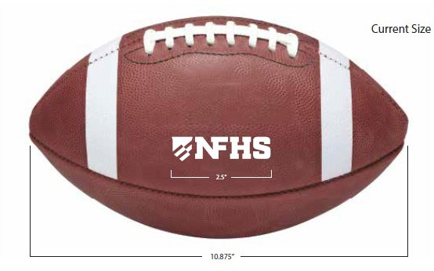
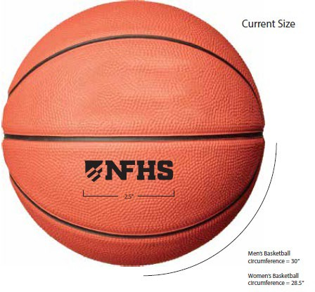
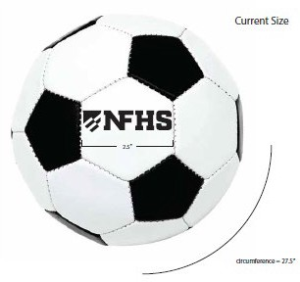
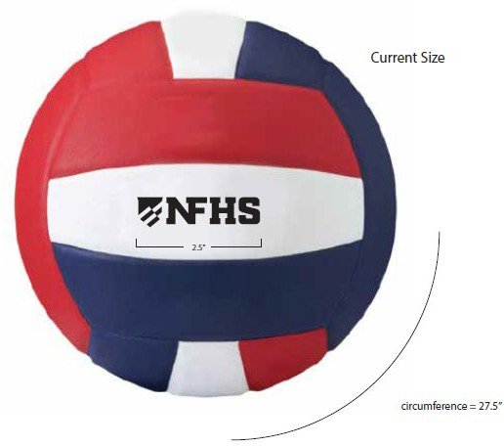
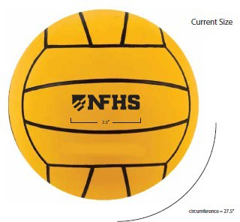
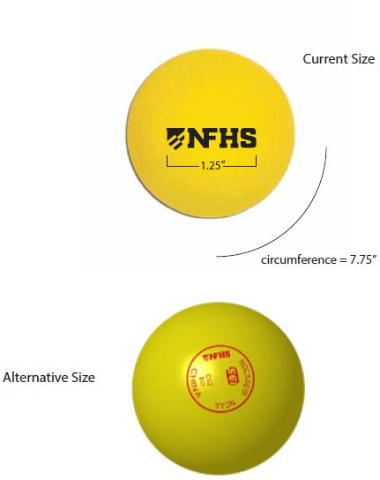
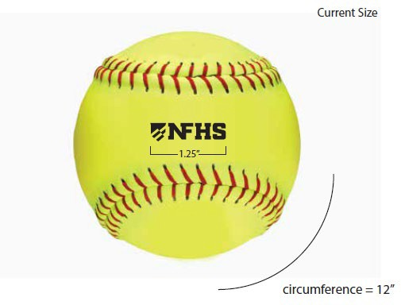
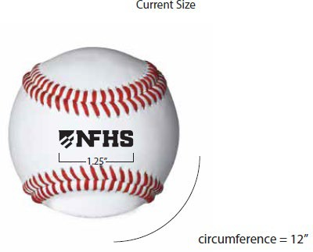
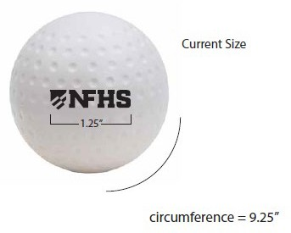
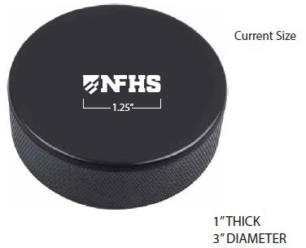
NFHS Authenticating Mark update
A current list of NFHS authenticated products can be found at www.nfhs.org, Resources, Authenticating Mark.

Slide 21
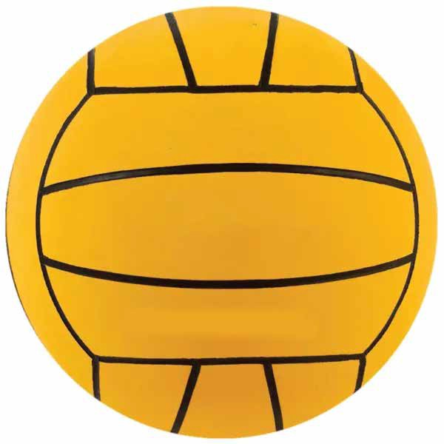


Water polo
Old Size
Current Size
OR
1.25”
2.5”
circumference = 27.5”
circumference = 27.5”

Slide 22
Editorial changes
2-4 NOTE
Removed the phrase referencing special needs of individual participants with disabilities related to accommodations.
Notes:
Rule 2-4 NOTE:
Removed the phrase referencing special needs of individual participants with disabilities related to accommodations.
Rationale: Aligns with current trends in language pertaining to individuals with a disability.

Slide 23
2024-26 NFHS water polo points of emphasis

Slide 24
Inside the goal area clarifications
Referees should be certain the player is inside the goal area when receiving the ball.
If the referees are not certain, they should assume the player was not inside the goal area.
Being on the line of the goal area is not considered being inside the goal area.
Notes:
INSIDE THE GOAL AREA CLARIFICATION
Referees should be certain the player is inside the goal area when receiving the ball. If the referees are not certain, they should assume the player was not inside the goal area. Being on the line of the goal area is not considered being inside the goal area.

Slide 25
Ball in hand
It should not be an ordinary foul or exclusion foul to “tackle” (hold, sink, pull back) an opponent in an attempt to steal the ball out of the hand of the attacker as long as those actions are not deemed violent or over-aggressive.
If an attacker is holding the ball and the attacker’s arm is grabbed or pulled, which jars the ball loose from the attacker's hand, a quick ordinary foul should not be given as no foul has been committed.
Notes:
BALL IN HAND
The rules book mentions in several places regarding fouls against a player “who is not holding the ball.” That is when a foul could be given. It should not be an ordinary foul or exclusion foul to “tackle” (hold, sink, pull back) an opponent in an attempt to steal the ball out of the hand of the attacker as long as those actions are not deemed violent or over-aggressive. If an attacker is holding the ball and the attacker’s arm is grabbed or pulled, which jars the ball loose from the attacker's hand, a quick ordinary foul should not be given as no foul has been committed.

Slide 26
advantage
The purpose of the advantage rule and the game itself is to score goals to
win the game.
The advantage rule clearly states that referees have the discretion to award
or not to award any foul depending on whether the decision would
advantage the attacking team.
Referees are to refrain from awarding a foul if it would be an advantage to
the offending team. If a player is holding the ball and/or is making progress
toward a greater advantage and an opportunity to score a natural goal, the
referees should allow that action to continue and not whistle a foul too
quickly.
Notes:
ADVANTAGE
The purpose of the advantage rule and the game itself is to score goals to win the game. The advantage rule clearly states that referees have the discretion to award or not to award any foul depending on whether the decision would advantage the attacking team. Referees are to refrain from awarding a foul if, in their opinion, awarding a foul would be an advantage to the offending team. If a player is holding the ball and/or is making progress toward a greater advantage and an opportunity to score a natural goal, the referees should allow that action to continue and not whistle a foul too quickly. The highest form of advantage is to score a goal, not to earn a foul. The advantage rule states that referees shall apply this principle to the fullest extent.

Slide 27
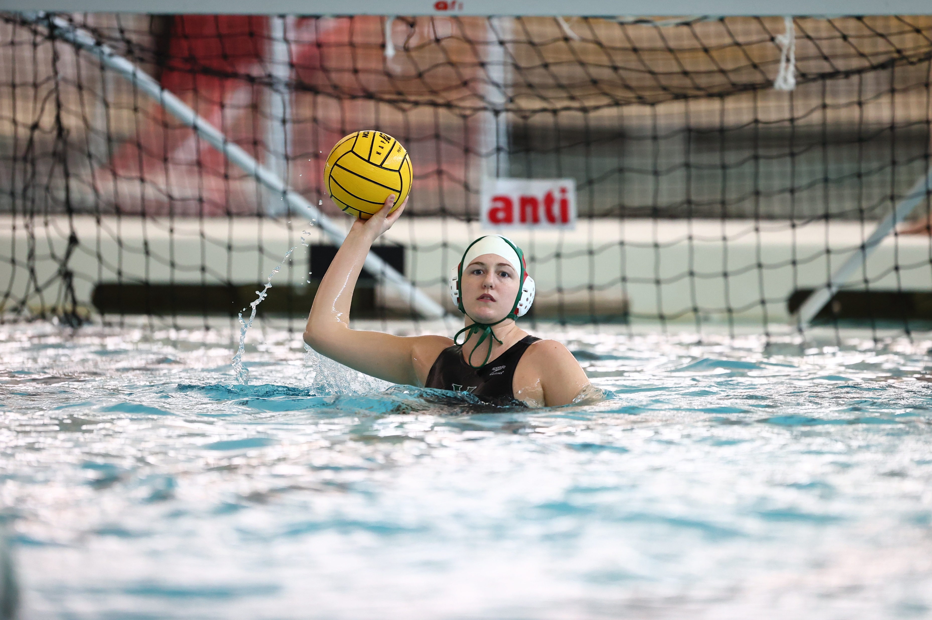


Officiating Water Polo
Course Description
Officiating water polo is a comprehensive course designed to equip aspiring referees with the skills and knowledge needed to become a proficient water polo official. This course will delve into the intricacies of the game’s rules, helping to hone your judgment and and decision-making abilities to ensure fair play and safety in every match. Whether you’re a seasoned official looking to enhance your expertise or a newcomer eager to dive into the world of water polo officiating, this course will provide you with the essential tools for success.
Notes:
Course Description
Officiating water polo is a comprehensive course designed to equip aspiring referees with the skills and knowledge needed to become a proficient water polo official. This course will delve into the intricacies of the game’s rules, helping to hone your judgment and and decision-making abilities to ensure fair play and safety in every match. Whether you’re a seasoned official looking to enhance your expertise or a newcomer eager to dive into the world of water polo officiating, this course will provide you with the essential tools for success.

